Slide 1
JOURNAL CLUB
PRESENTER:
Dr SAI SUMANTH
RESIDENT, INT MEDICINE
MODERATOR:
WG CDR ROHIT VASHISHT
INFECTIOUS DISEASE SPECIALIST

Slide 2
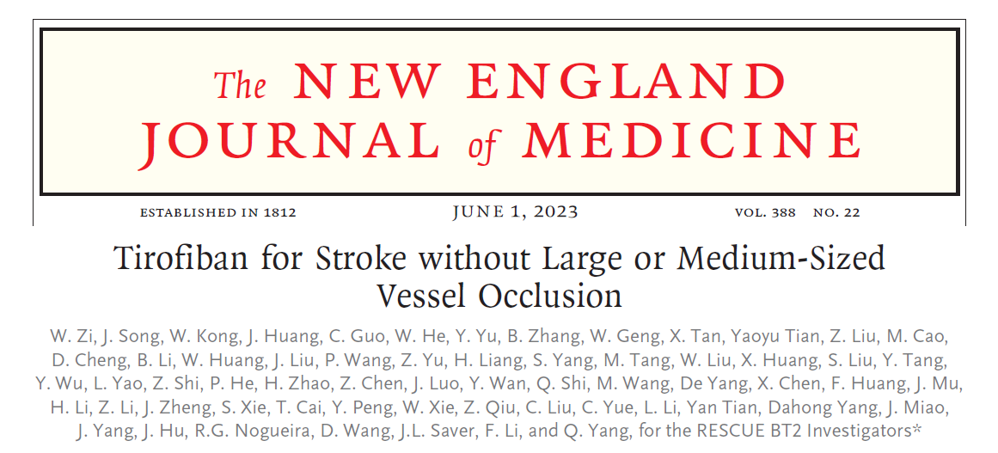
NEJM, 01 Jun 2023

Slide 3
BACKGROUND
Treatments designed to reverse or lessen the amount of tissue infarction and improve clinical outcome
Medical support
IV thrombolysis
(3) Endovascular revascularization
(4) Antithrombotic treatment
(5) Neuroprotection
(6) Stroke centers and rehabilitation

Slide 4
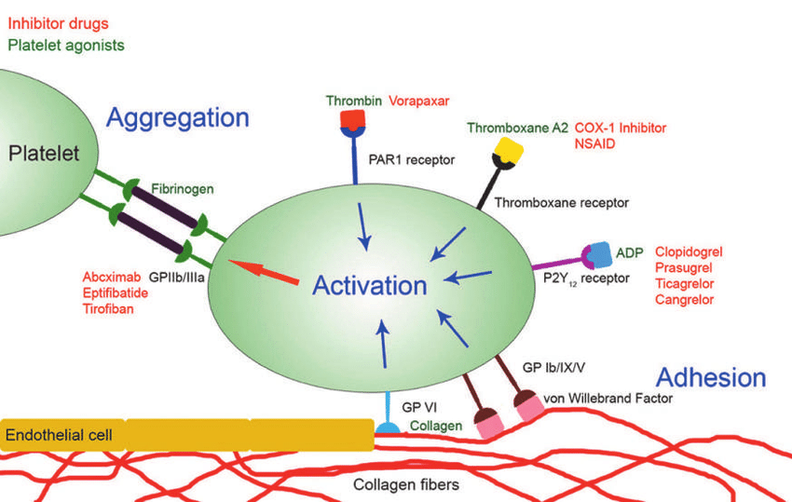
Notes:
the Systolic Blood Pressure Intervention Trial—SPRINT
SPARCL -The
Stroke Prevention by Aggressive Reduction in Cholesterol Levels (SPARCL) trial
Clopidogrel versus Aspirin in Patients at Risk of Ischemic Events (CAPRIE)
The Management of Atherothrombosis with Clopidogrel in High-Risk Patients (MATCH
Clopidogrel for High Atherothrombotic Risk and Ischemic Stabilization, Management, and Avoidance (CHARISMA)

Slide 5
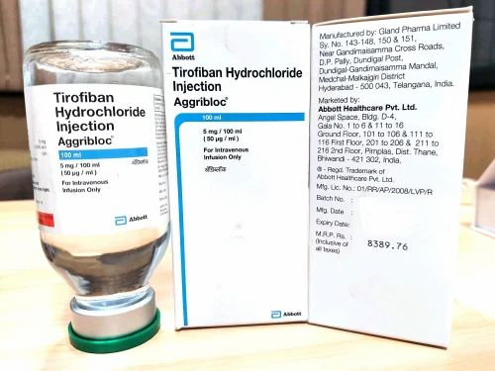
Tirofiban
Fast-acting
Highly selective
Low molecular weight non-peptide
glycoprotein IIb/IIIa receptor inhibitor
with a short half-life
Notes:
that allows
bleeding time to revert to normal within
approximately 3 hours after its administration is
stopped.

Slide 6
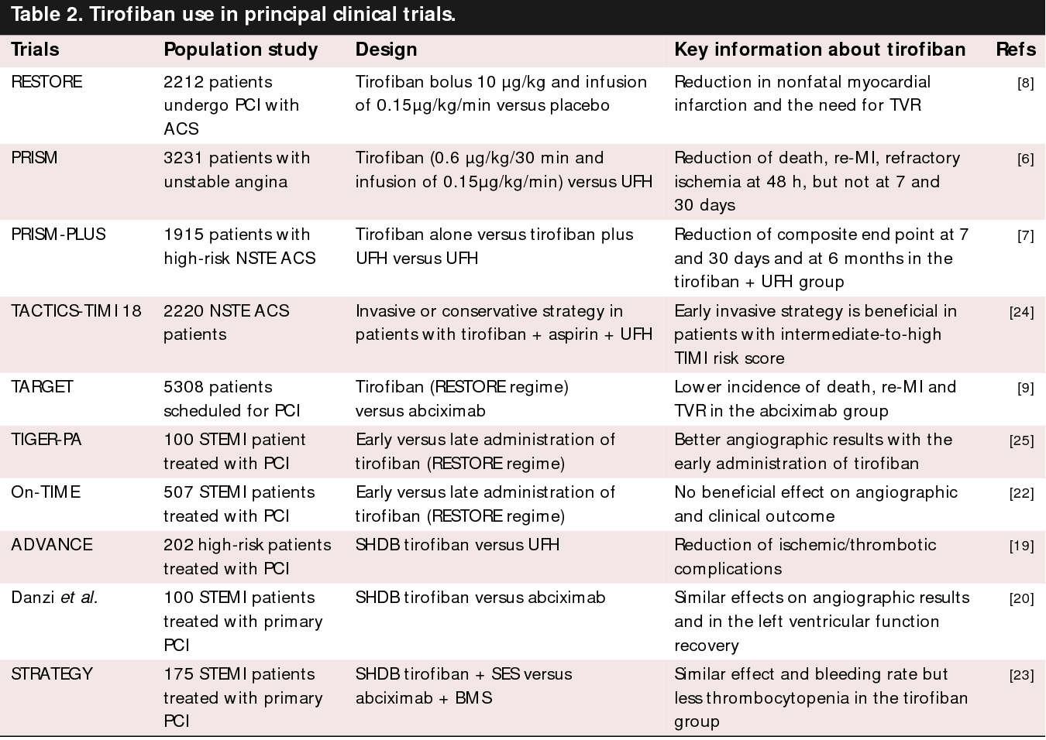

Slide 7
Safety and efficacy of low-dose rt-PA with tirofiban to treat acute non-cardiogenic stroke: a single-center randomized controlled study
Liang Z, Zhang J, Huang S, Yang S, Xu L, Xiang W, Zhang M. Safety and efficacy of low-dose rt-PA with tirofiban to treat acute non-cardiogenic stroke: a single-center randomized controlled study. BMC Neurol. 2022 Jul 27;22(1):280. doi: 10.1186/s12883-022-02808-w. PMID: 35897006; PMCID: PMC9327332.
Low-dose rt-PA combined with tirofiban in acute non-cardiogenic ischemic stroke did not increase the risk of ICH, and mortality, and it was associated with neurological improvement
Notes:
Background and purpose: The recanalization rate after intravenous thrombolysis (IVT) is not enough and there is still the possibility of re-occlusion. We aim to investigate the effectiveness and safety of infusing tirofiban after IVT.
Methods: We performed a prospective controlled study of 60 patients with acute non-cardiogenic ischemic stroke who were hospitalized in Yantai Yuhuangding Hospital from January 2018 to December 2019. The patients were divided into 2 groups: those who received tirofiban for 24 h after IVT (rt-PA + T group) and those who did not receive postprocedural intravenous tirofiban (rt-PA group). The rt-PA + T group received low-dose rt-PA (0.6 mg/kg). The rt-PA group received standard dose rt-PA (0.9 mg/kg). The main outcome measure were safety, included the symptomatic intracranial hemorrhage (sICH), any ICH, severe systemic bleeding, and mortality. The secondary outcome measure is curative efficacy which were evaluated by the 7d-NIHSS score and functional outcomes at 90 days. During hospitalization, the deterioration of neurological function was recorded.
Results: All patients completed the follow-up with complete data, there were 30 patients in each of groups. The general characteristics between the two group patients had no statistically significant differences. Compared with the rt-PA + T group and the rt-PA group, in terms of safety, the rates of the sICH, severe systemic bleeding, and mortality in both groups were 0, and there was no statistically significant difference in the rates of any ICH between the two groups (10.0% vs. 3.3%, P = 0.306). In terms of efficacy, the rate of the early neurological deterioration events (END) was no statistical significance (0 vs. 6.6%, P = 0.246). There was no significant difference in the NIHSS score between the two groups before the IVT, and also at 24 h, however, the 7d-NIHSS score was lower in the rt-PA + T group compared with the rt-PA group (2.33 ± 1.85 vs. 4.80 ± 4.02, P = 0.004). At 90 days, 83.3% of patients in the rt-PA + T group had favorable functional outcomes compared with 60.0% of patients in the rt-PA group (P = 0.045).
Conclusions: Low-dose rt-PA combined with tirofiban in acute non-cardiogenic ischemic stroke did not increase the risk of ICH, and mortality, and it was associated with neurological improvement.

Slide 8
Early tirofiban administration for patients with acute ischemic stroke treated with intravenous thrombolysis or bridging therapy: Systematic review and meta-analysis
Liu Q, Lu X, Yang H, Deng S, Zhang J, Chen S, Shi S, Xun W, Peng R, Lin B, Li T, Pan L, Weng B. Early tirofiban administration for patients with acute ischemic stroke treated with intravenous thrombolysis or bridging therapy: Systematic review and meta-analysis. Clin Neurol Neurosurg. 2022 Nov;222:107449. doi: 10.1016/j.clineuro.2022.107449. Epub 2022 Sep 21. PMID: 36162161.
In AIS patients who underwent IVT or bridging therapy, early administration of tirofiban may be effective and safe, but further studies are needed to confirm the efficacy.

Slide 9
The efficacy and safety of intravenous tirofiban in the treatment of acute ischemic stroke patients with early neurological deterioration
Du Y, Li Y, Duan Z, Ma C, Wang H, Liu R, Li S, Lian Y. The efficacy and safety of intravenous tirofiban in the treatment of acute ischemic stroke patients with early neurological deterioration. J Clin Pharm Ther. 2022 Dec;47(12):2350-2359. doi: 10.1111/jcpt.13816. Epub 2022 Dec 2. PMID: 36461632.
Tirofiban injection exhibited a high safety profile and significantly improved the prognosis of AIS-END patients who missed the intravenous thrombolysis time window.
Notes:
What is known and objective: Many patients with acute ischemic stroke (AIS) develop early neurological deterioration (END), leading to disabilities or death. Thus, this study aimed to investigate the efficacy and safety of intravenous tirofiban in treating patients with AIS and END who missed the thrombolysis time window.
Methods: A total of 123 AIS-END patients participated in the study between January 2021 and December 2021. Patients were randomized into the tirofiban group (n = 63) and the control group (n = 60) based on whether a tirofiban injection was administered. The National Institute of Health Stroke Scale (NIHSS) was used to assess neurological function at the 48th hour and on the 7th day after intervention, and the modified Rankin Scale (mRS) was used to assess neurological recovery 90 days after AIS. Adverse reactions during the intervention were recorded for safety analysis.
Results and discussion: The 7th day NIHSS and 90th day post-AIS mRS scores of the tirofiban group were significantly lower than those of the control group (p < 0.05), while the 90th day good prognosis (mRS ≤ 2) rate of the tirofiban group was significantly higher (84.13% vs. 65.00%, p < 0.05). Logistic regression demonstrated a protective effect of tirofiban for good prognosis in AIS patients with END (OR = 4.675, 95% CI [1.012-21.605], p < 0.05). No cases of intracranial haemorrhage transformation or death were observed during the treatment in either group.
What is new and conclusion: Tirofiban injection exhibited a high safety profile and significantly improved the prognosis of AIS-END patients who missed the intravenous thrombolysis time window.

Slide 10
Effect of Intravenous Tirofiban vs Placebo Before Endovascular Thrombectomy on Functional Outcomes in Large Vessel Occlusion Stroke: The RESCUE BT Randomized Clinical Trial
RESCUE BT Trial Investigators; Qiu Z, Li F, Sang H, Luo W, Liu S, Liu W, Guo Z, Li H, Sun D, Huang W, Zhang M, Zhang M, Dai W, Zhou P, Deng W, Zhou Z, Huang X, Lei B, Li J, Yuan Z, Song B, Miao J, Liu S, Jin Z, Zeng G, Zeng H, Yuan J, Wen C, Yu Y, Yuan G, Wu The RESCUE BT Randomized Clinical Trial. JAMA. 2022 Aug 9;328(6):543-553. doi: 10.1001/jama.2022.12584. PMID: 35943471; PMCID: PMC9364124.
Treatment with intravenous tirofiban, compared with placebo, before endovascular therapy resulted in no significant difference in disability severity at 90 days. The findings do not support use of intravenous tirofiban before endovascular thrombectomy for acute ischemic stroke.
Incidence of symptomatic intracranial hemorrhage was 9.7% in the tirofiban group vs 6.4% in the placebo group
Notes:
Objective: To assess the efficacy and adverse events of intravenous tirofiban before endovascular thrombectomy for acute ischemic stroke secondary to large vessel occlusion.
Design, setting, and participants: This investigator-initiated, randomized, double-blind, placebo-controlled trial was implemented at 55 hospitals in China, enrolling 948 patients with stroke and proximal intracranial large vessel occlusion presenting within 24 hours of time last known well. Recruitment took place between October 10, 2018, and October 31, 2021, with final follow-up on January 15, 2022.
Interventions: Participants received intravenous tirofiban (n = 463) or placebo (n = 485) prior to endovascular thrombectomy.
Main outcomes and measures: The primary outcome was disability level at 90 days as measured by overall distribution of the modified Rankin Scale scores from 0 (no symptoms) to 6 (death). The primary safety outcome was the incidence of symptomatic intracranial hemorrhage within 48 hours.
Results: Among 948 patients randomized (mean age, 67 years; 391 [41.2%] women), 948 (100%) completed the trial. The median (IQR) 90-day modified Rankin Scale score in the tirofiban group vs placebo group was 3 (1-4) vs 3 (1-4). The adjusted common odds ratio for a lower level of disability with tirofiban vs placebo was 1.08 (95% CI, 0.86-1.36). Incidence of symptomatic intracranial hemorrhage was 9.7% in the tirofiban group vs 6.4% in the placebo group (difference, 3.3% [95% CI, -0.2% to 6.8%]).
Conclusions and relevance: Among patients with large vessel occlusion acute ischemic stroke undergoing endovascular thrombectomy, treatment with intravenous tirofiban, compared with placebo, before endovascular therapy resulted in no significant difference in disability severity at 90 days. The findings do not support use of intravenous tirofiban before endovascular thrombectomy for acute ischemic stroke.

Slide 11
Association between intravenous tirofiban and intracranial hemorrhage in acute large vessel occlusion stroke: insight from the RESCUE BT randomized placebo-controlled trial
In patients with acute large vessel occlusion stroke, intravenous tirofiban before EVT within 24 h of time from last known well is not associated with increased risk of SICH. Patients who are older, have more severe neurological deficits, or with cardioembolism are at higher risk of SICH with intravenous tirofiban.

Slide 12
Efficacy and Safety of Tirofiban in Clinical Patients With Acute Ischemic Stroke – ESCAPIST Trial
Han B, Ma T, Liu Z, Wu Y, Tan W, Sun S, Li X, Shao C, Tang D, Sun J. Efficacy and Safety of Tirofiban in Clinical Patients With Acute Ischemic Stroke. Front Neurol. 2022 Feb 8;12:785836. doi: 10.3389/fneur.2021.785836. PMID: 35211073; PMCID: PMC8860815.
Mild-to-moderate stroke NIHSS 4- 15
Cardioembolic stroke excluded
< 12 hrs of onset
Tirofiban was safe and effective and might be a remedial treatment for patients with AIS who did not receive recanalization treatments

Slide 13
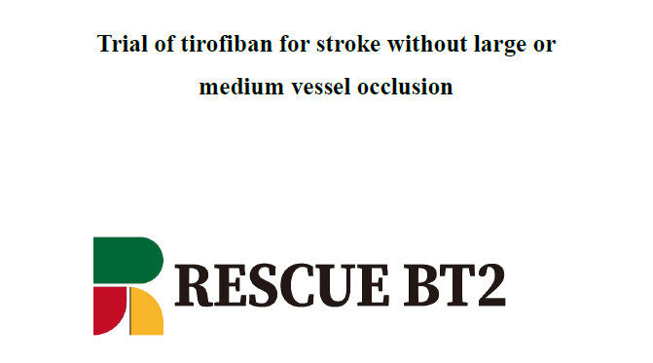

Slide 14
RESCUE BT 2 TRIAL
The brief window of time for successful
intervention after stroke onset and
the contraindications to treatment limit
the use of intravenous thrombolysis (IVT)
Endovascular thrombectomy (EVT)
is effective mainly for strokes due to the occlusion
of large or medium-sized vessels

Slide 15
Who present within 24 hours after stroke onset but are ineligible for intravenous or endovascular reperfusion therapy
Who have not been treated with reperfusion therapies because they have patent proximal cerebral vessels but have progression of stroke symptoms 24 to 96 hours after onset
Who receive IVT but have early neurologic deterioration or no neurologic improvement after treatment
Notes:
As a result, there are many patients with recent onset or recent progression of acute stroke with stenosis
of large or medium-sized vessels or occlusion
of penetrating arteries or distal branch vessels,
presumed to be due mainly to atherosclerosis,
but without large or medium-sized artery occlusion,
for whom currently available therapies may
not be appropriate

Slide 16
AIM
RESCUSE BT2 TRIAL
To study the Efficacy and Satefty effects of the glycoprotein IIb/IIIa receptor inhibitor tirofiban compared with Aspirin in the treatment of patients with
acute ischemic stroke without complete occlusion of large or medium-sized vessels

Slide 17
METHODS
Investigator initiated , Multicenter, Randomized, Double-blinded Double dummy Placebo-controlled, Phase 3 trial
Study Centres A total of 117 stroke centres in China
Number of Subjects 1177
Study Duration October 2020 (first patient in) until October 2022 (data base lock)

Slide 18
Inclusion Criteria
Aged 18 years or older;
Any of the following presentations of AIS:
A. Within 24 hours of time last known well and ineligible for IVT
or EVT
B. More than 24 hours and less than 96 hours after time last known well but within 24 hours of ischemic stroke progression and ineligible for IVT or EVT without ICH confirmed by CT scan or MRI.
Notes:
[worsening of ≥ 2 points on the National Institutes of Health Stroke
Scale (NIHSS)]

Slide 19
NIHSS score ≥ 5 immediately prior to trial entry, including at least one limb with
NIHSS motor item score 2-4
Without visible large or medium intracranial vessel occlusion on CT angiography (CTA), MR angiography (MRA), or digital subtraction angiography (DSA).
Qualifying mechanisms are:
a) Hypo perfusion caused by arterial stenosis;
b) The initial occluded large or medium artery spontaneously recanalized or recanalized with IV tPA before the vascular imaging performed;
c) Multiple or single distal emboli from cardiac or other sources in arterial branches too small to visualized on CTA or MRA;
d) Lacunar infarct due to small vessel occlusion
Written informed consent obtained from patients or their legal
representatives.

Slide 20
Exclusion Criteria
CT or MR evidence of intracranial hemorrhage
Pre-morbid disability with a pre-stroke modified Rankin scale (mRS) score ≥ 2
Presence of any of the following unequivocal cardiac sources of embolism:
chronic or paroxysmal atrial fibrillation,
sick sinus syndrome,
mitral stenosis,
mechanical valve,
endocarditis,
intra-cardiac clot or vegetation,
myocardial infarction within three months,
dilated cardiomyopathy,
left atrial spontaneous echo contrast,
ejection fraction less than 30%

Slide 21
Exclusion Criteria
Planned treatment with dual antiplatelet therapy within 1week of the index stroke
Any history of a primary intracerebral (parenchymal) haemorrhage
Any history of other intracranial hemorrhage (intraventricular, subarachnoid, subdural, epidural);
Any untreated or incompletely treated intracranial aneurysm or any intracranial vascular malformation

Slide 22
Exclusion Criteria
Major systemic haemorrhage within 30 days;
Active bleeding diathesis, including clinical laboratory evidence of coagulation abnormalities (platelet count < 100 * 10^9 /L, activated partial thromboplastin time > 50 seconds or international normalized ratio > 1.7), or treatment with a direct oral anticoagulant within the prior 48h;
Any major surgery within 14 days of the index stroke;
Systolic pressure greater than 180 mmHg or diastolic pressure greater than 110 mmHg after aggressive treatment;
Severe renal insufficiency (glomerular filtration rate < 30 ml/min or serum creatinine > 220 μmol/L [2.5 mg/dl]);
Known allergy or contraindication to tirofiban or aspirin;
Currently pregnant or lactating;
Any intracranial tumour (except small meningioma);
Any terminal illness with life expectancy less than 6 months;
Pre-existing neurological or psychiatric disease that would confound the neurological functional outcome evaluations;
Unlikely to be available for 90-day follow-up;
Current participation in another treatment clinical trial.

Slide 23
PROCEDURE
Randomization: Web Based app www.Jinlingshu.com
Stratification: permutation block size of 4
Tirofiban + Placebo
1:1 Randomization
Aspirin + Placebo

Slide 24
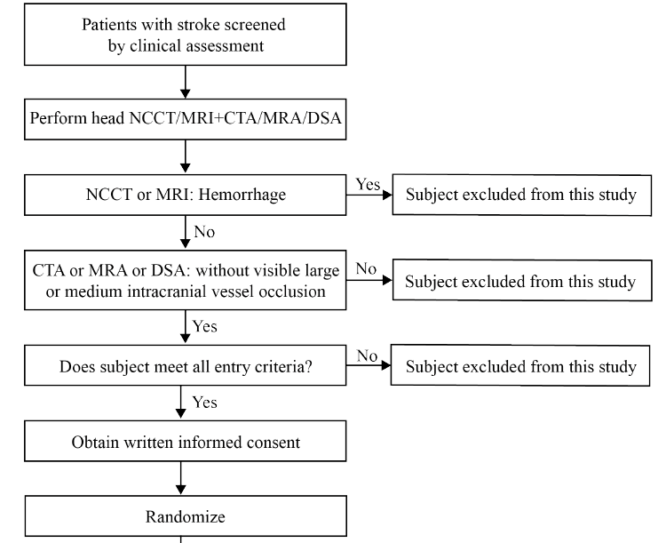
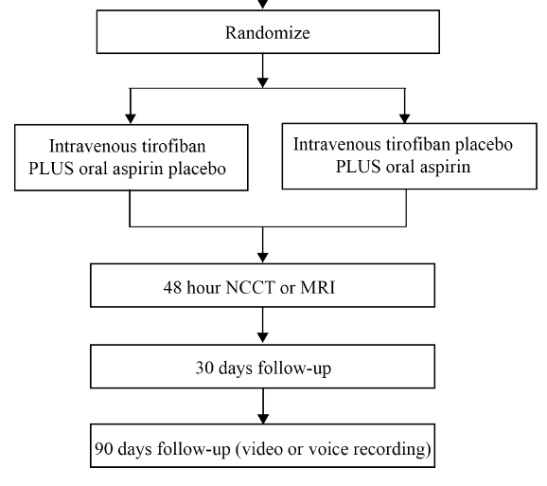

Slide 25
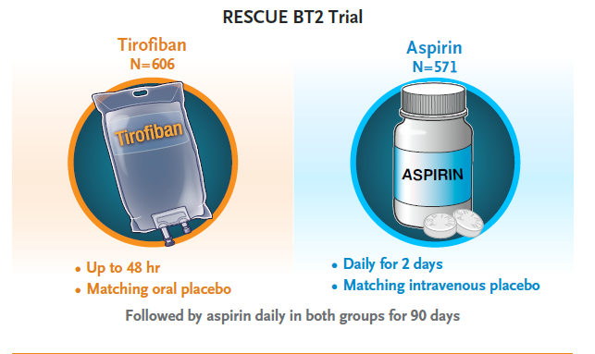
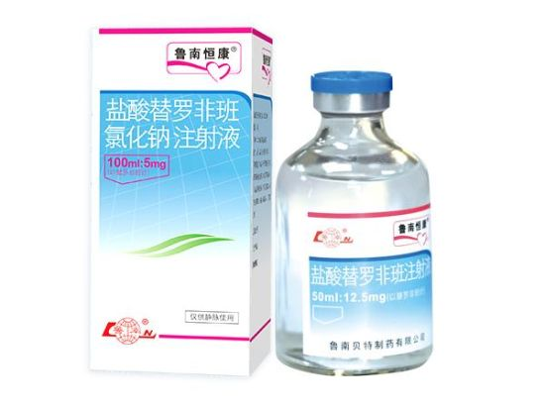
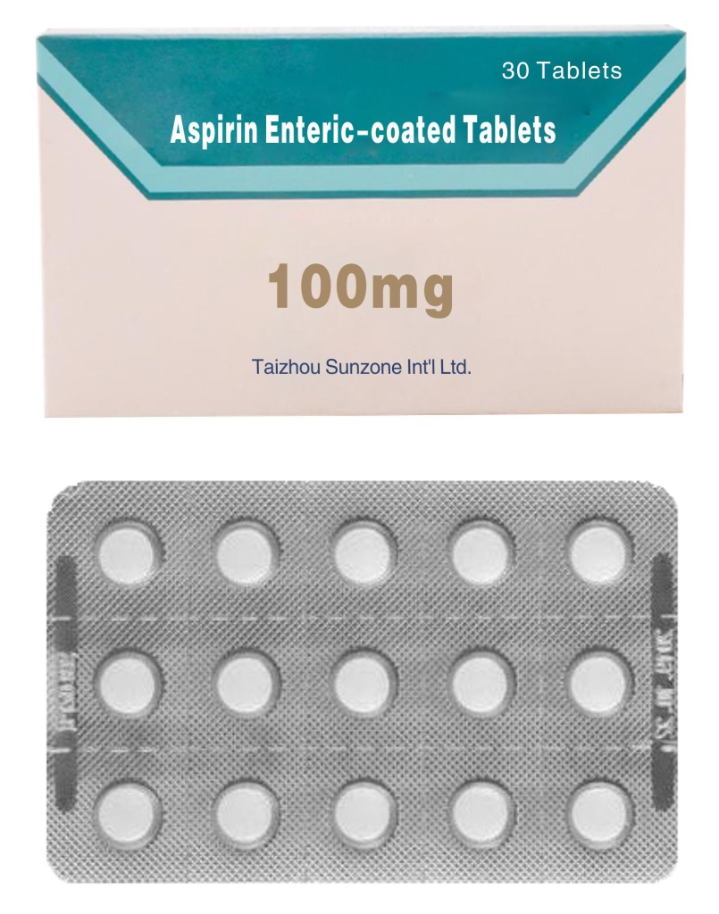
Notes:
Tirofiban group: The box of tirofiban group contains tirofiban
hydrochloride injection (12.5 mg/50 ml * 2 bottles, the bottles are
marked as Study Drug), and placebo of aspirin enteric-coated
tablets (100mg/tablet * 2 tablets).
Aspirin group: The box of placebo group contains saline placebo
(0.9% NaCl, 50 ml * 2 bottles, the bottles are marked as Study
Drug), and aspirin enteric-coated tablet (100mg/tablet * 2 tablets).

Slide 26
PROCEDURE
Intravenous tirofiban was administered at a dose of 0.4 μg per kilogram of body weight per minute for 30 minutes, followed by a continuous infusion of 0.1 μg per kilogram per minute for up to 48 hours. Patients in the tirofiban group also received oral placebo daily for 2 days
Patients in the aspirin group were assigned to receive intravenous placebo and oral aspirin (100 mg per day) for 2 days.
Beginning approximately at the 44th hour after administration of intravenous tirofiban or placebo, all the patients received oral aspirin at a dose of 100 mg per day until day 90.

Slide 27
OUTCOMES
Primary Efficacy End point:
The proportion of patients with excellent functional outcome,
defined as a mRS score of 0 to 1 at 90 ±7 days after stroke.

Slide 28
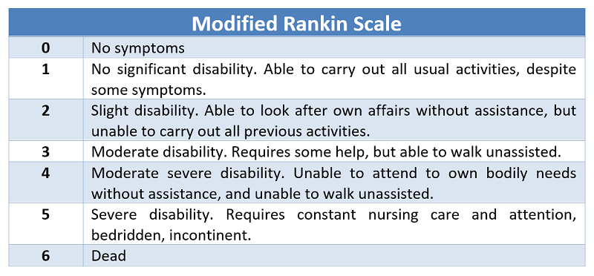

Slide 29
Secondary Efficacy Endpoints
Global Outcome Score (combination of mRS score 0 to 1,
NIHSS score 0 to 1, Barthel Index 95 to 100, and Glasgow
Outcome Scale score 5) at 90 ±7 days;
Reduced disability level (ordinal shift in mRS score) at 90
±7 days;
Proportion of patients with functional independence (mRS
score 0 to 2) at 90 ±7 days;
Health-related quality of life [European Quality of Life Five-
Dimension Five-Level scale (EQ-5D-5L)] at 90 ±7 days.
An excellent out come score -Proportion of mRS score 0 to 1 at 30 ±3 days;
Functional independent score -Proportion of mRS score 0 to 2 at 30 ±3 days;
Notes:
Barthel higher indicate better independence
EQ-5D 0.39 to 1 lower is worse

Slide 30
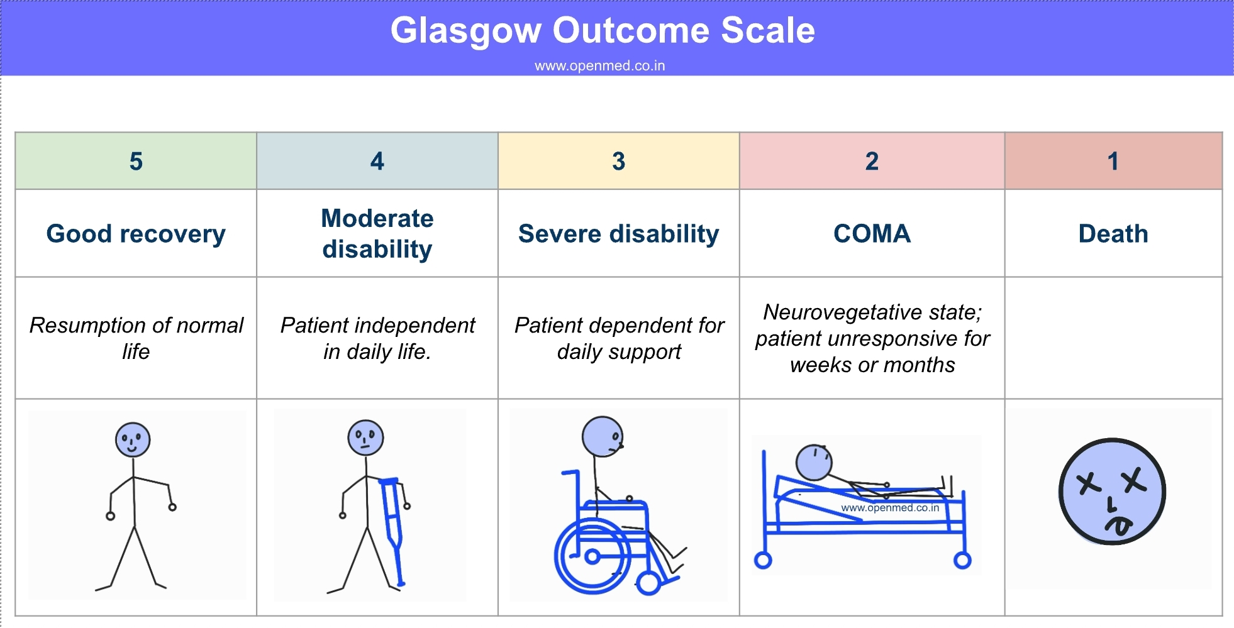

Slide 31
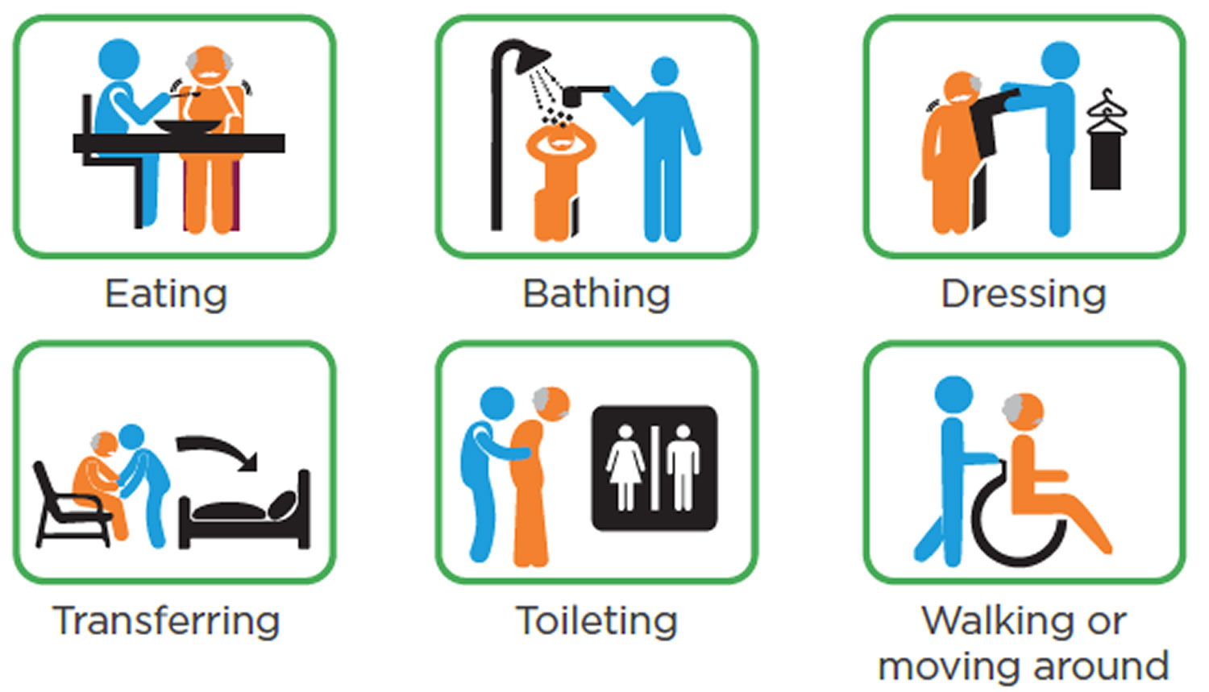
Barthel Index

Slide 32
Primary Safety Endpoints
Mortality at 90 ±7 days
Proportion of patients with symptomatic intracranial
hemorrhage within 48 hours
Symptomatic intracranial hemorrhage will be adjudicated by an independent Imaging Core Laboratory according to the modified Heidelberg Bleeding Classification

Slide 33
Secondary Safety Endpoints
Proportion of patients with any radiologic intracranial
haemorrhage within 48 hours
Incidence of any adverse events
If there were signs of neurologic deterioration indicating
cerebral hemorrhage, further imaging was to be
conducted for follow-up.

Slide 34
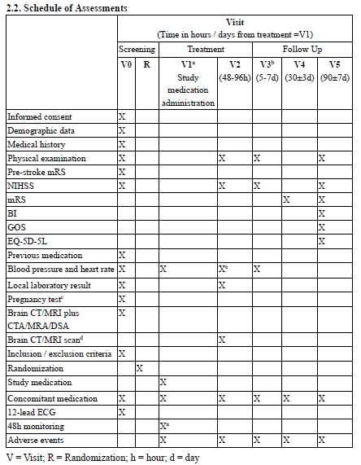

Slide 35
STATISTICAL ANALYSIS

Slide 36
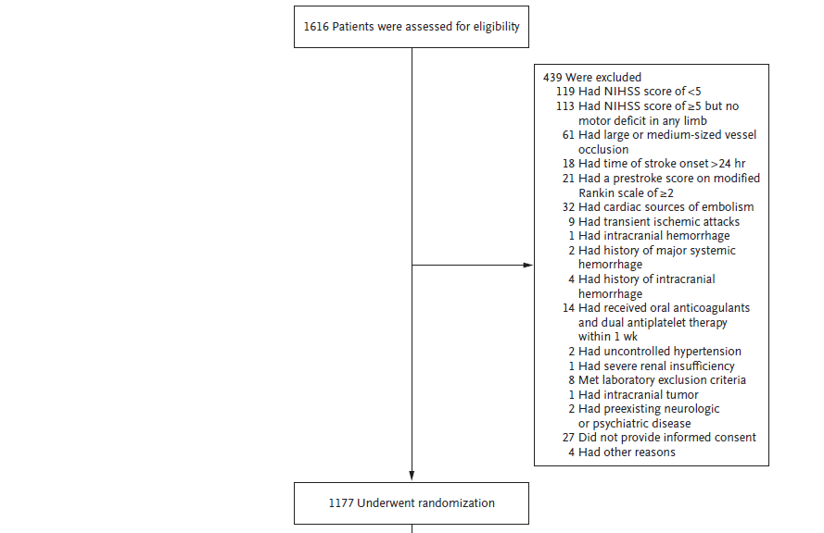
STUDY PROFILE

Slide 37
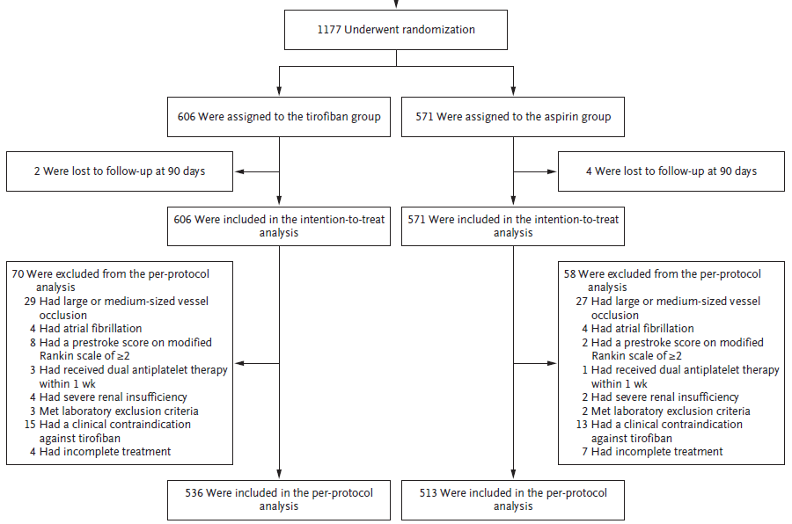

Slide 38
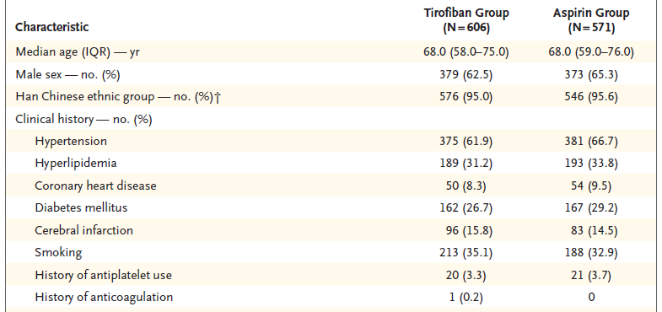
DEMOGRAPHIC DATA

Slide 39
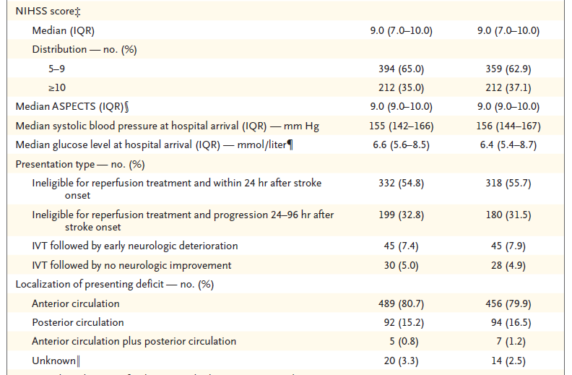

Slide 40
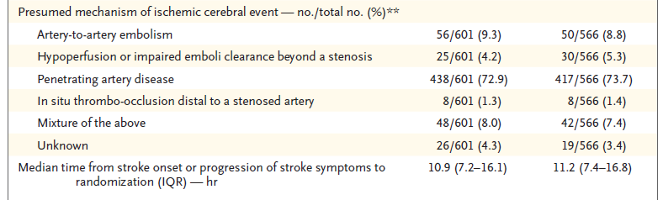
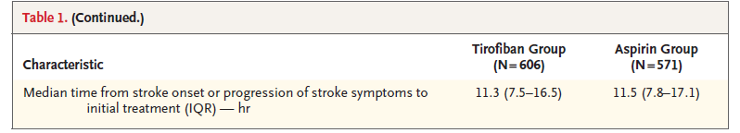

Slide 41
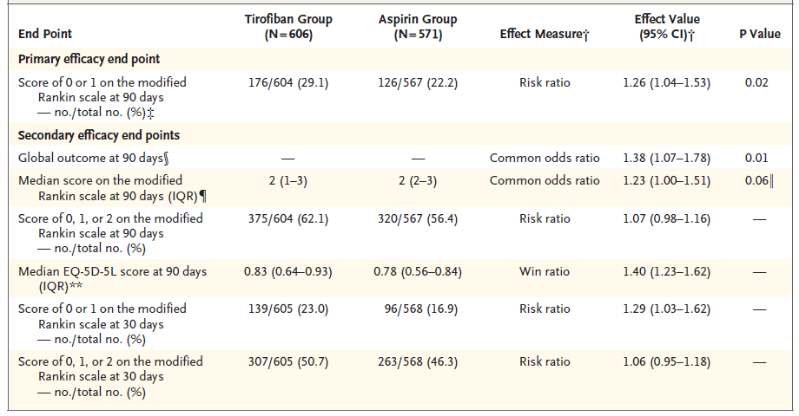
RESULTS

Slide 42
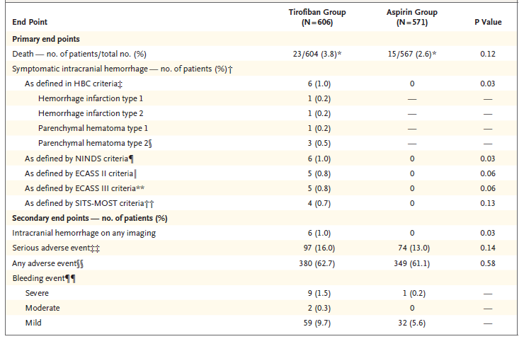
SAFETY ENDPOINTS
Notes:
European Cooperative Acute Stroke Study (ECASS)
The Safe Implementation of Thrombolysis in Stroke-Monitoring Study (SITS-MOST)

Slide 43
RESULTS
Efficacy:
Primary end point
Among evaluable patients, the percentage with an
excellent outcome was significantly higher in the tirofiban
group than in the aspirin group (29.1% (176 of 604) vs. 22.2% (126 of 567) ; P =0.02)
Safety:
Mortality at 90 days was similar in the two groups
Symptomatic intracranial hemorrhage within 48 hours
occurred only in the tirofiban group

Slide 44
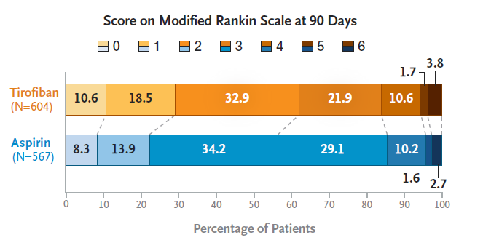

Slide 45
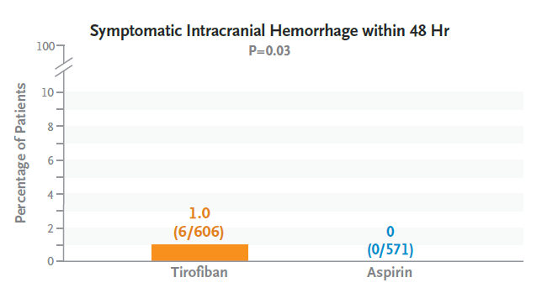

Slide 46
CRITICAL APPRAISAL

Slide 47
CRITICAL APPRAISAL
TITLE
Is it interesting? YES
ABSTRACT
Will the conclusions (if valid), likely to be useful to you, in your area of clinical practice or research? YES
Whether the settings in the material methods are similar to our own settings? YES

Slide 48
REFERENCE QUESTION
Is there a clear cut / specific research question? YES
Was it feasible for the authors to study this question given there technical expertise and available facilities? YES
Does the research question has some element of novelty? YES

Slide 49
VALIDITY
Have the authors made a mention of Actual / Study Population ? YES
Is the method of sampling been described? YES
Whether a mention of all the potential confounding factors been made? YES
Any selection or information bias could have occurred? NO

Slide 50



GATE Framework Assessment : PECOT
Participants: 1177
P
Tirofiban-Placebo
: 606
Aspirin- Placebo : 571
OUTCOME: an excellent outcome at 90 days
O
DURATION : Oct 2020 – Oct 2022
T

Slide 51
ASSESSING VALIDITY

Slide 52
The RAMMbo acronym : Assessing study bias
P
E
C
O
T
P
Recruitment
Allocation
Maintenance
Measurement of outcome
Blind or Objective
E
C
O
T

Slide 53
RAMMbo : Recruitment
Study setting & eligibility criteria well described ? YES
Participants representative of eligible ? YES
Prognostic/risk profile appropriate to study question? YES
Randomization process described adequately? YES

Slide 54
RAMMbo: A is for Allocation
1177
1:1 ratio for baseline randomization
Randomization
Tirofiban-Placebo
: 606
Aspirin- Placebo : 571
O

Slide 55
RAMMbo
Good Maintenance ?
Did most participants remain in allocated groups ? yes
Participants &/or investigators blind to exposure (and comparison exposure)? YES
Compliance high & similar in EG &CG? yes
Completeness of follow-up high & similar in EG &CG? yes
O

Slide 56
RAMMbo
P
Measurement of outcomes
blind or objective?
EG CG
Outcome measurements were YES
Authors reviewed all results YES
O
T

Slide 57
Recruitment
Bias: No bias
P
Allocation : Adequate
E C
Maintenance: Good Retention
Measurement : Right Statistical tools (of outcomes)
O
T

Slide 58
STRENGTHS
Large scale study compared to previous studies
Included population with moderate to major motor deficits in at least one limb at entry, a factor that is associated with poor final outcomes
Distinct from ESCAPIST, the current trial enrolled patients with more severe symptoms (median NIHSS score at baseline of 9, as compared with 5 or 6 in the ESCAPIST trial) and allowed for an extended time window (24 hours vs. 12 hours), which may have resulted in a lower incidence of an excellent outcome in our trial

Slide 59
LIMITATIONS
Broader clinical presentation of patients which limited the generalizability of the trial results to greater population
Only a small proportion of enrolled patients had been treated with IVT
The observed incidences of an excellent outcome in both trial groups were lower than expected
Follow-up imaging at 24 to 36 hours in the absence of neurologic worsening was not required, which limits ascertainment of the incidence of asymptomatic hemorrhagic transformation.
Notes:
This might be because a
large proportion of patients were recruited from
nonacademic hospitals and may not have received
out-of-hospital rehabilitation after their
strokes, limiting functional recovery in both
groups

Slide 60
CONCLUSION
Among patients with acute ischemic stroke of recent onset and no large or medium-sized intracranial vessel occlusion and who were not eligible for reperfusion therapy or whose symptoms progressed after thrombolysis, intravenous tirofiban resulted in a greater likelihood of an excellent outcome at 90 days than oral aspirin
Results for secondary end points did not consistently support the primary end-point analysis
The incidence of symptomatic intracranial hemorrhage was low in both groups but slightly higher with tirofiban.

