Slide 1
JOURNAL CLUB
PRESENTER:
CAPT MUKTI NATH
JR 2
INTERNAL MEDICINE
MODERATOR:
COL Y UDAY
PROFESSOR MEDICINE AND
CLINICAL HEMATOLOGIST

Slide 2
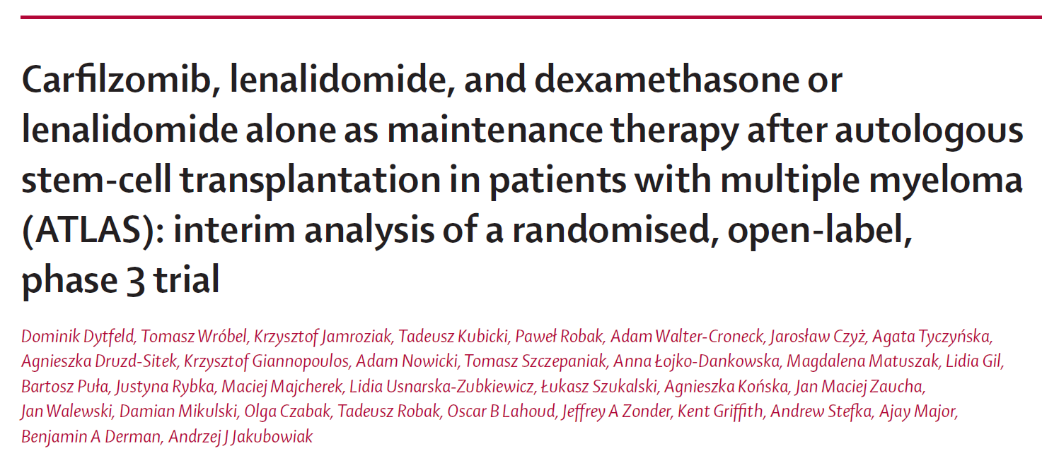
LANCET Oncology
January 12, 2023

Slide 3
BACKGROUND
Lenalidomide is used as maintenance therapy in patients with newly diagnosed multiple myeloma after autologous stem-cell transplantation

Slide 4
BACKGROUND
ATLAS TRIAL
Aimed to compare the efficacy and safety of maintenance therapy with carfilzomib, lenalidomide, and dexamethasone versus lenalidomide alone

Slide 5
PRIMARY OBJECTIVE
To compare progression free survival between carfilzomib and lenalidomide arm

Slide 6
SECONDARY OBJECTIVE
To determine the rate of MRD-negative disease at 6 and 12 months
after randomization
To compare the efficacy of carfilzomib vs. Lenalidomide alone after randomization
To evaluate the safety and tolerability of carfilzomib compared to
lenalidomide alone
Notes:
efficacy (rate of PR, VGPR, CR, and sCR)

Slide 7
STUDY DESIGN
Investigator-initiated, multicenter, open-label, randomized, phase 3 trial
12 academic and clinical centers in the USA and Poland
Duration of Study: Patient assignment between June 2016 to Oct 2020.
Patient follow up till 4 years of last patient enrolled
Sample size : 180 (120-140 in Poland and 40-60 in the US)
Treatment on protocol for up to 36 months

Slide 8
RANDOMIZATION
Patient randomly assigned 1:1
Receive carfilzomib, lenalidomide, and dexamethasone or lenalidomide alone
Randomization done between day 70 and day 120 after autologous stem-cell transplantation
Notes:
using permuted blocks (random block sizes of 4 and 6)
web-based system (REDCap, Vanderbilt University, Nashville, TN, USA).

Slide 9
INCLUSION CRITERIA
Age : 18 years and above
Single autologous stem cell transplant after completion of at most 2 induction regimens
Within 12 months of initiation of induction therapy
Stable disease prior to randomization in the first 100 days after stem cell transplantation
ECOG performance status of 0-1

Slide 10
EXCLUSION CRITERIA
Patients who have had more than 12 months of prior therapy
Patients who progressed after initial therapy
More than two regimens for induction
Already received post-transplant maintenance or consolidation regimen
Not able to tolerate lenalidomide or carfilzomib or dexamethasone
Notes:
Potential subjects with evidence of progressive disease as per
IMWG criteria

Slide 11
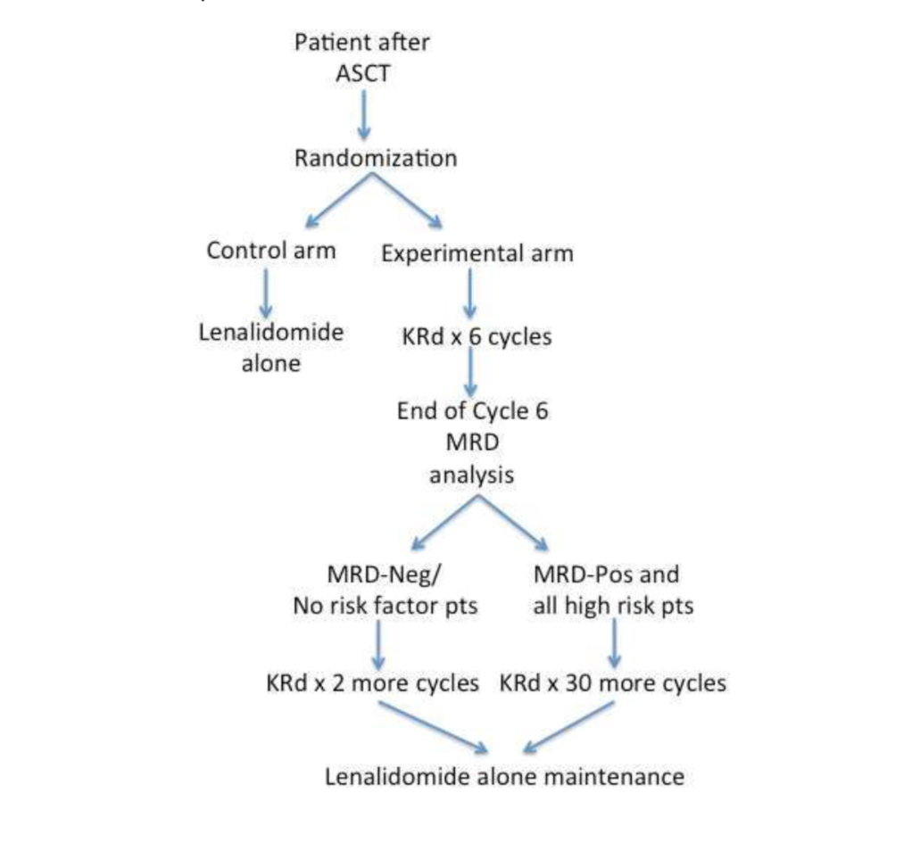
METHOD

Slide 12
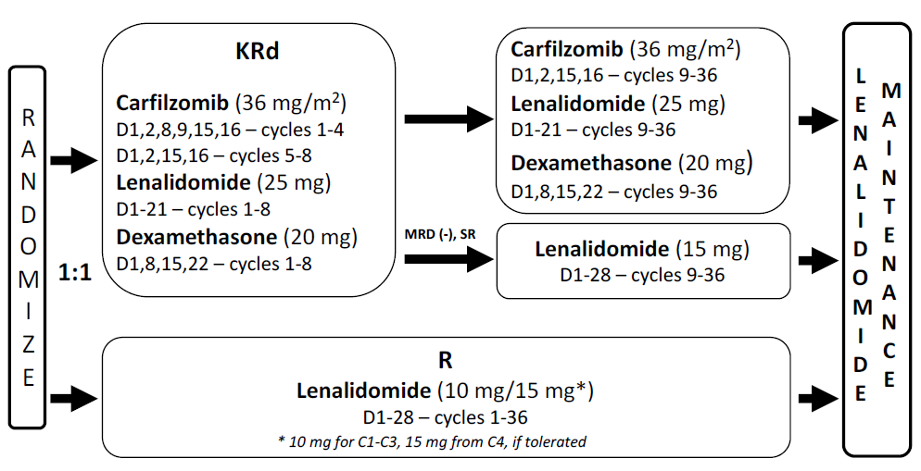
METHOD
Notes:
Treatment was to be initiated between day 80 and day 130 after autologous stem-cell transplantation
To limit the risk of toxic effects and financial burden of the treatment, patients in the carfilzomib, lenalidomide, and dexamethasone group with no detectable minimal residual disease after cycle six (defined by the IMWG as at least 10– ⁵ sensitivity and at least a complete response)18 and protocol-defined, standard-risk cytogenetics (ie, no high-risk cytogenetic features) were switched to lenalidomide maintenance
After 36 protocol-defined cycles, patients in both treatment groups received or continued to receive lenalidomide maintenance.

Slide 13
MONITORING RESPONSE
Serum and urine protein electrophoresis
Serum Free Light Chains
Serum quantitative immunoglobulins
Bone marrow samples for plasma cell quantification, FISH and MRD analyses
Notes:
Bone marrow at screening and the end of cycles 6, 12, 18, 24, and 36, at assessment of response for suspected complete response, at the end of treatment, and then once per year for up to 5 years from random assignment

Slide 14
OUTCOMES
Primary endpoint:
Progression-free survival measured from randomization to disease progression or death from any cause
Notes:
Progression-free survival measured from randomization to disease progression or death from any cause, whichever occurred first

Slide 15
OUTCOMES
Secondary endpoints :
Rate of minimal residual disease negativity at 6, 12, 18, 24, and 36 months
Correlation of minimal residual disease negativity with progression-free survival, duration of minimal residual disease negativity
Overall survival
Safety

Slide 16
STATISTICAL ANALYSIS

Slide 17
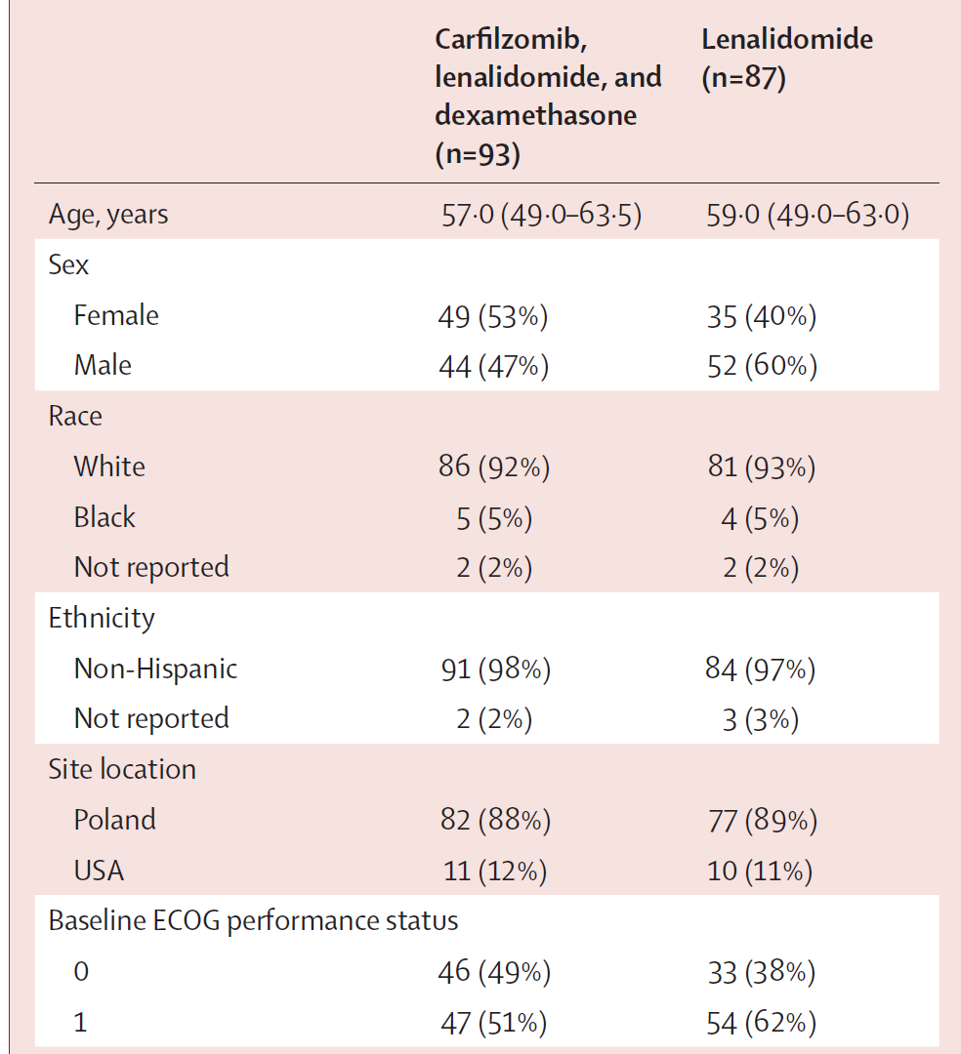
BASELINE CHARACTERISTICS

Slide 18
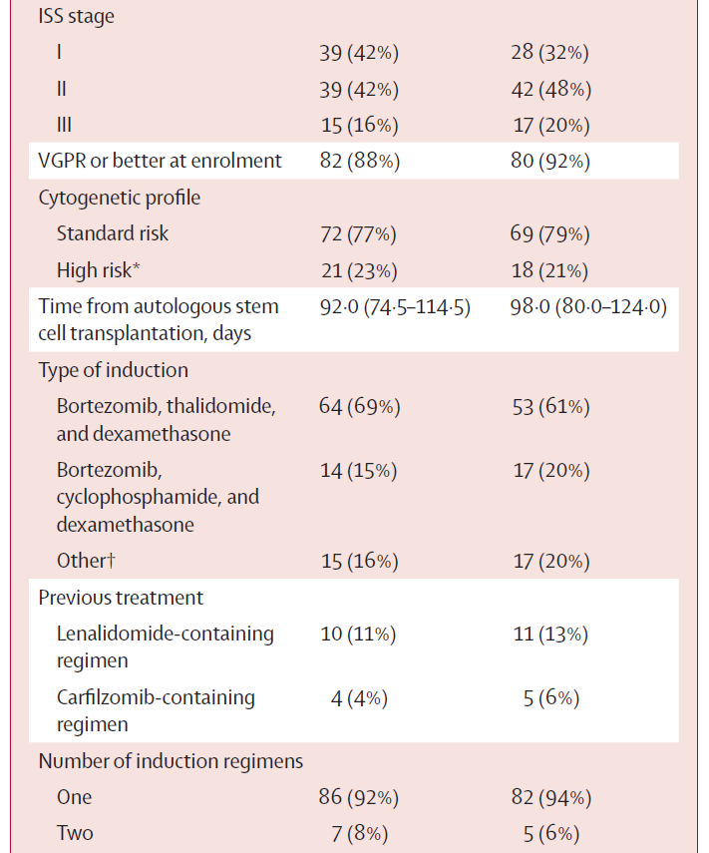
BASELINE CHARACTERISTICS

Slide 19
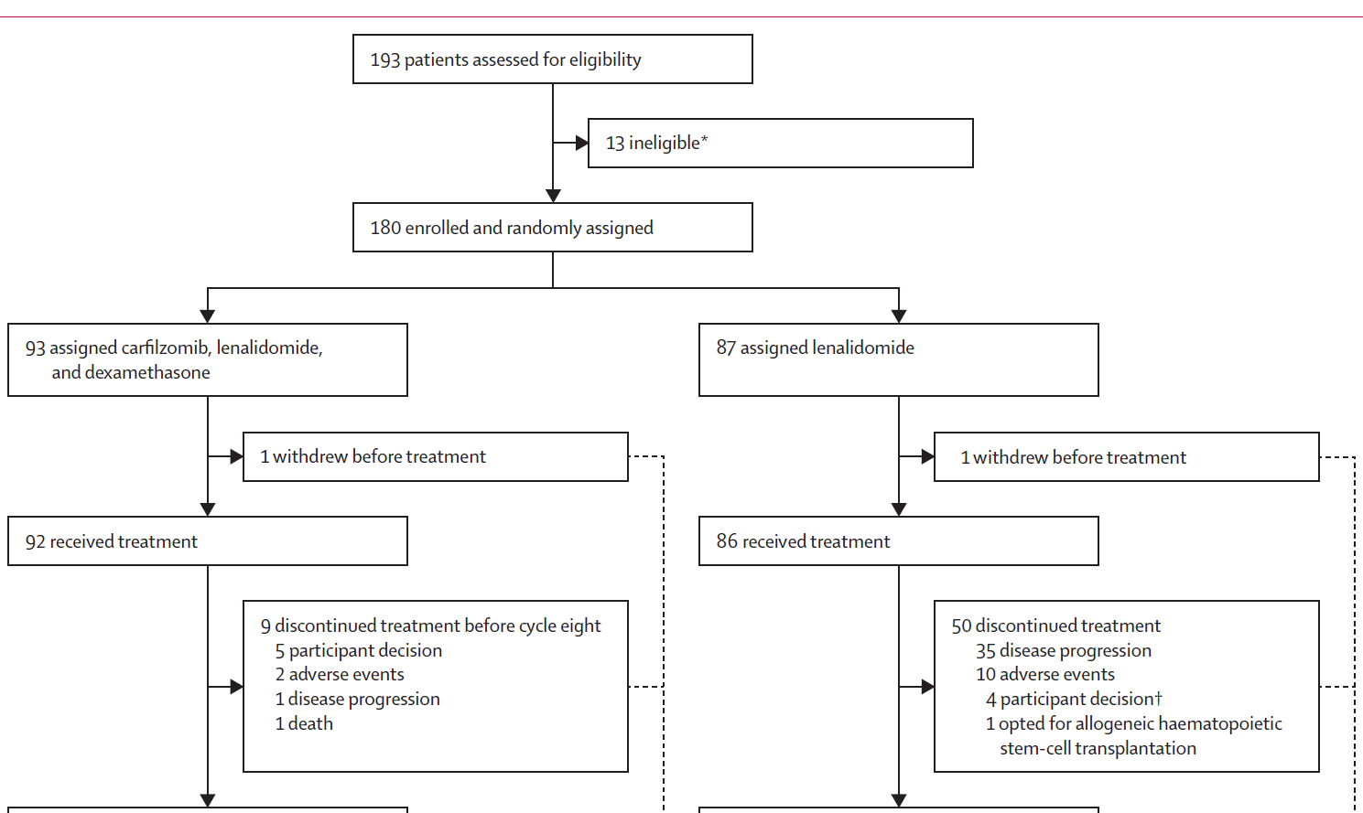
STUDY PROFILE
Notes:
Potential subjects with evidence of progressive disease as per
IMWG criteria

Slide 20
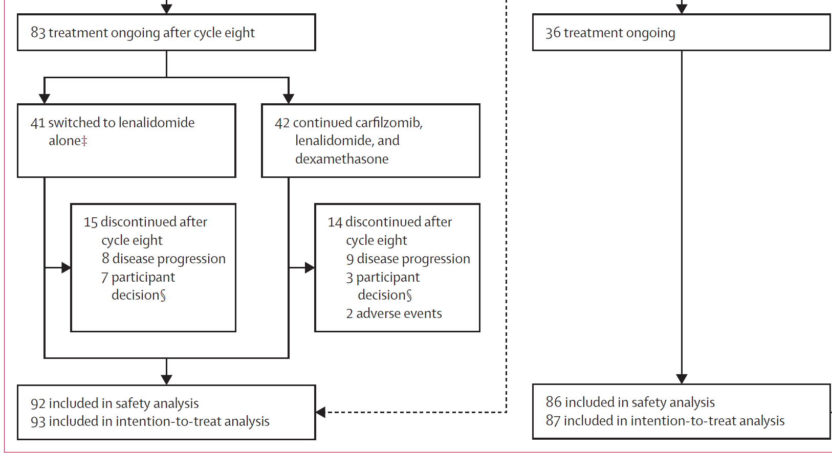
STUDY PROFILE
Notes:
Potential subjects with evidence of progressive disease as per
IMWG criteria

Slide 21
RESULTS
After a median follow-up of 33.8 months, there were 61 progression-free survival events : 23 in the KRd arm vs 38 in the lenalidomide arm
Risk of disease progression was reduced by 44% (P = .026) with KRd)
Overall survival

Slide 22
RESULTS
Median progression free survival
59.1 month in KRd arm
41.4 months in Linalidomide arm
No significant difference in overall survival between two arms
Rate of MRD negativity higher in KRd arm 53% vs 21 in lenalidomide arm

Slide 23
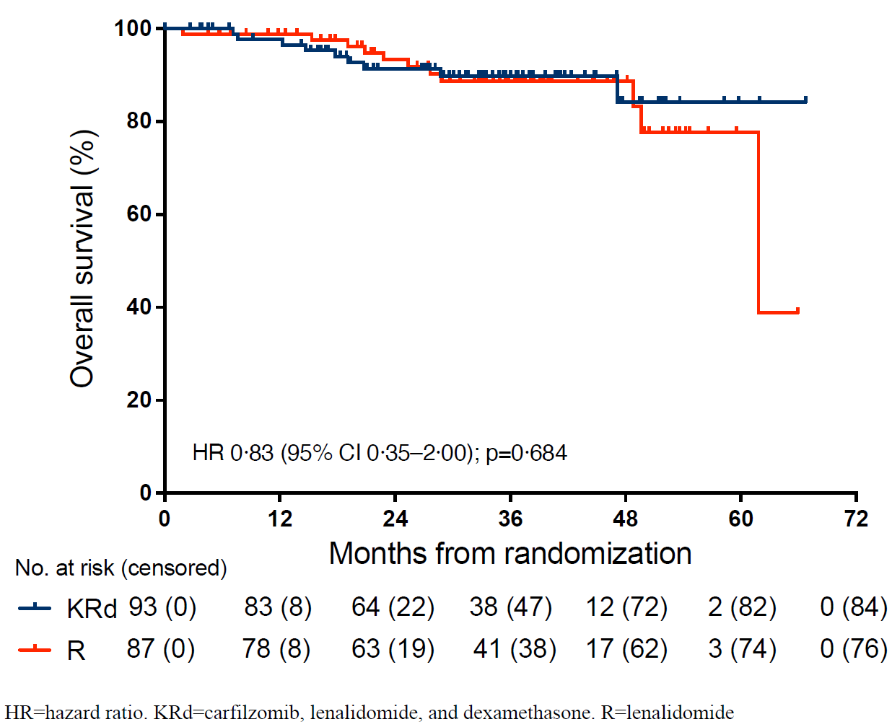
RESULTS
Overall survival

Slide 24
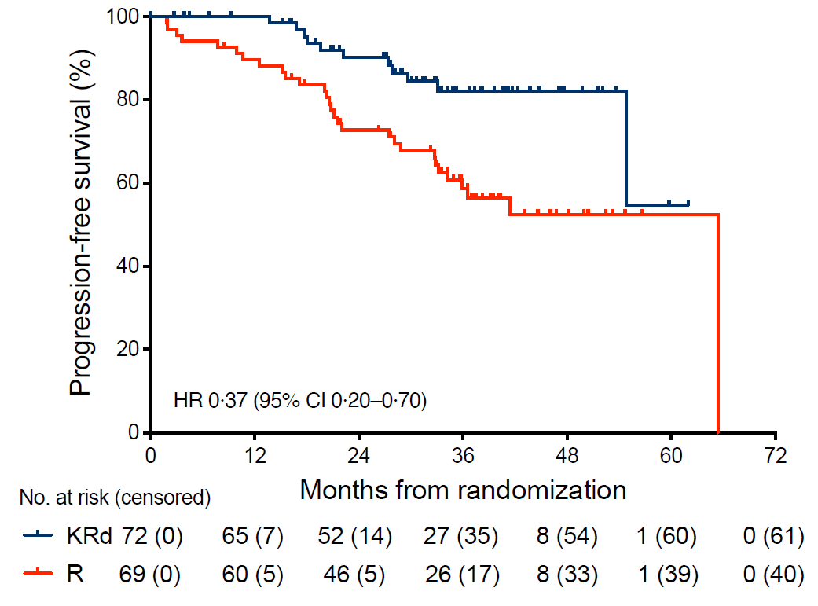
RESULTS
Progression free survival in standard risk disease

Slide 25
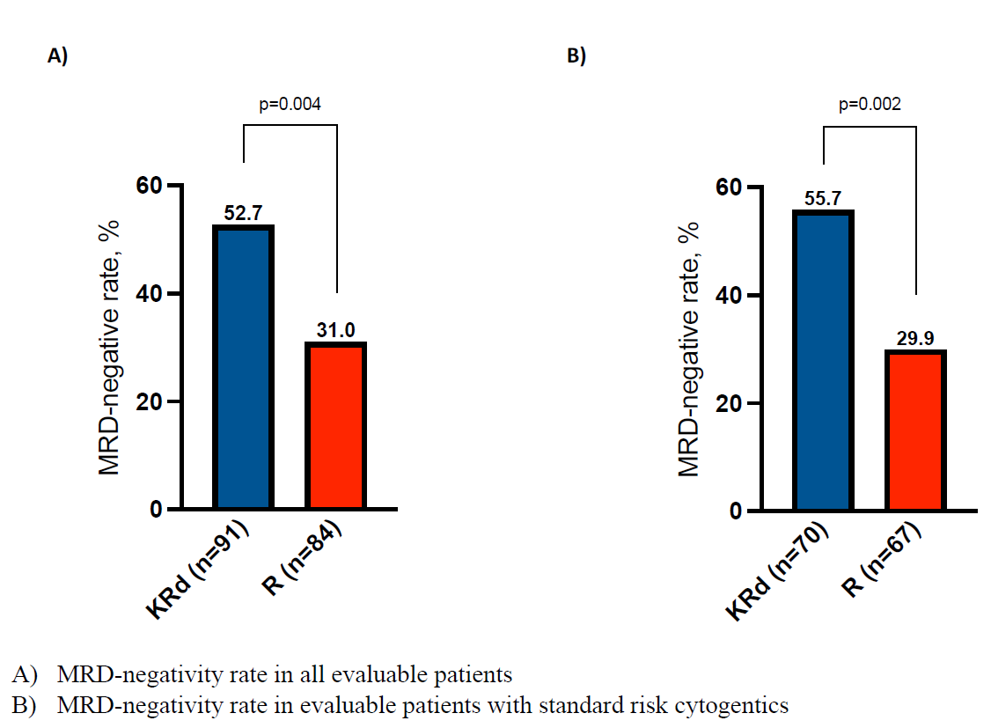
RESULTS

Slide 26
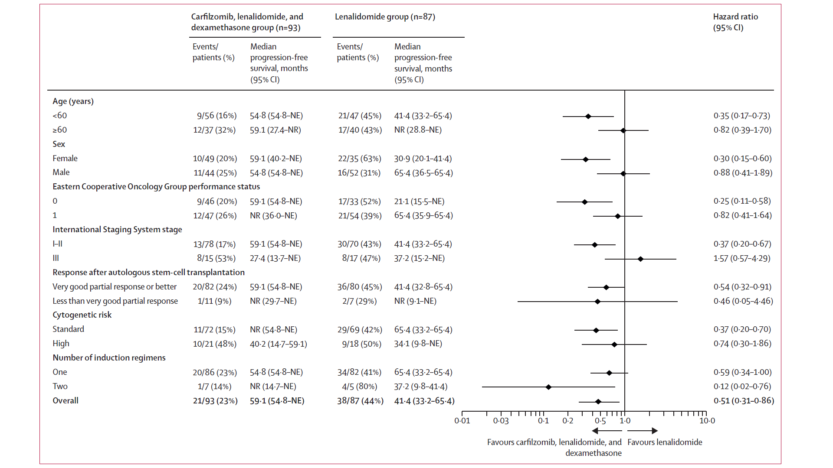
RESULTS
Sub group analysis of progression free survival

Slide 27
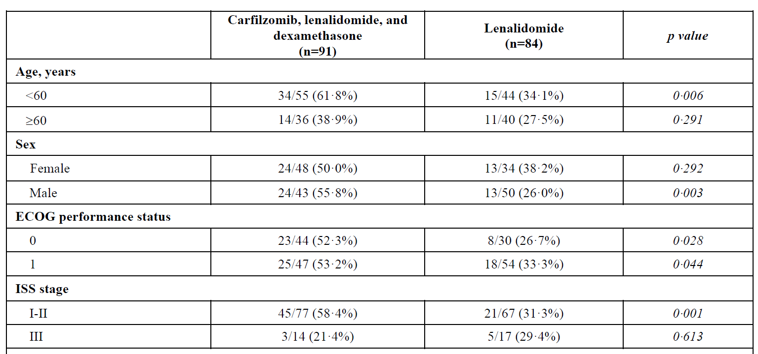
RESULTS

Slide 28
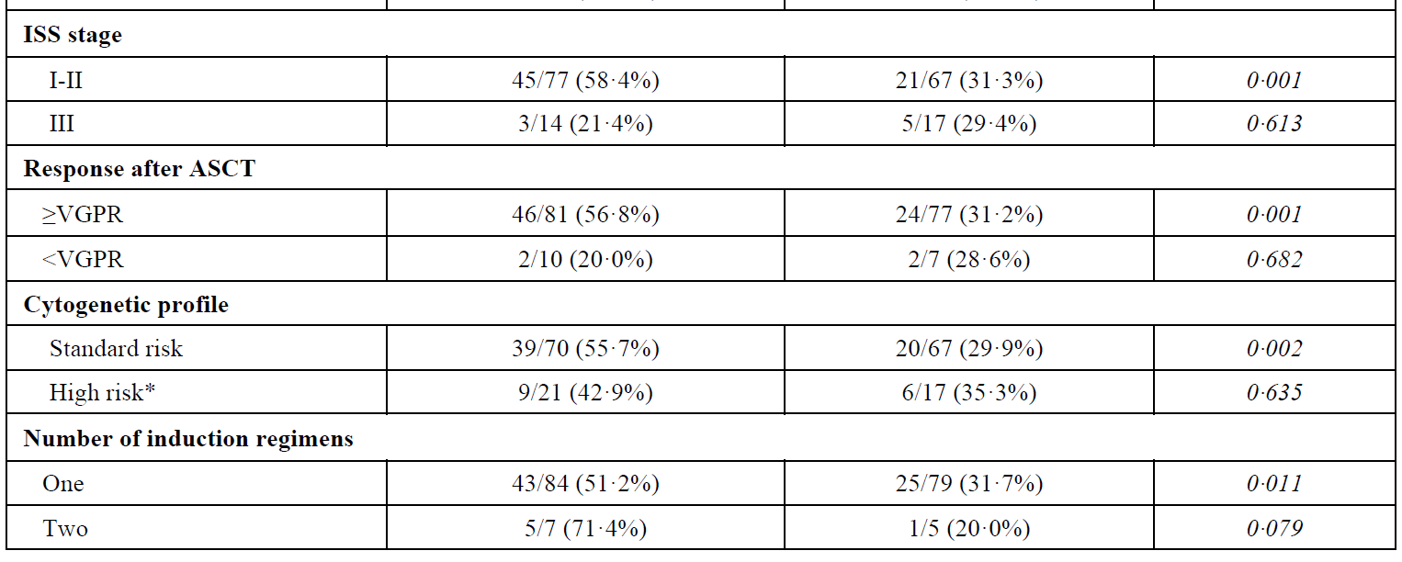
RESULTS

Slide 29
ADVERSE EVENTS
Grade I and II adverse events higher in KRd arm -93% vs 83% in lenalidomide group
Grade 3 and 4 adverse events- 76% in KRd arm vs 73 % lenalidomide group
Serious adverse events occurred in 30 % KRd arm vs 22% in lenalidomide group

Slide 30
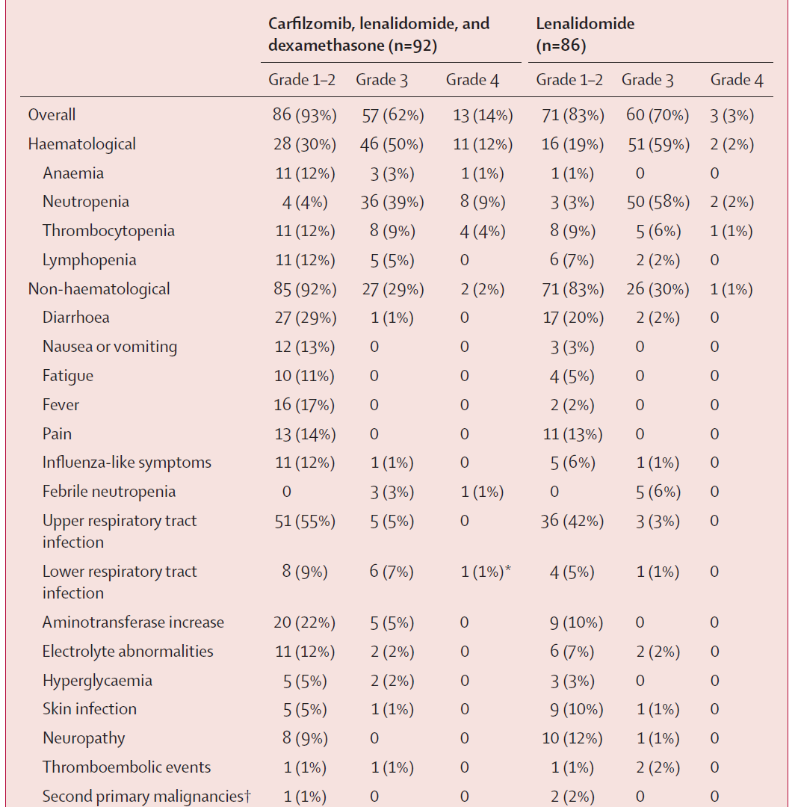
ADVERSE EVENTS

Slide 31
CRITICAL APPRAISAL

Slide 32
CRITICAL APPRAISAL
TITLE
Is it interesting? YES
ABSTRACT
Will the conclusions (if valid), likely to be useful to you, in your area of clinical practice or research? YES
Whether the settings in the material methods are similar to our own settings? YES

Slide 33
REFERENCE QUESTION
Is there a clear cut / specific research question? YES
Was it feasible for the authors to study this question given there technical expertise and available facilities? YES
Does the research question has some element of novelty? YES

Slide 34
VALIDITY
Have the authors made a mention of Actual / Study Population ? YES
Is the method of sampling been described? YES
Whether a mention of all the potential confounding factors been made? NO
Any selection or information bias could have occurred? NO

Slide 35



GATE Framework Assessment : PECOT
PARTICIPANTS: 180
P
KRd:93
Linalidomide:87
OUTCOME: Progression free survival better in between carfilzomib arm compared to lenalidomide arm
O
DURATION : 36months
T

Slide 36
ASSESSING VALIDITY

Slide 37
The RAMMbo acronym : Assessing study bias
P
E
C
O
T
P
Recruitment
Allocation
Maintenance
Measurement of outcome
Blind or Objective
E
C
O
T

Slide 38
RAMMbo : Recruitment
Study setting & eligibility criteria well described ? YES
Participants representative of eligible ? YES
Prognostic/risk profile appropriate to study question? YES
Randomization process described adequately? YES

Slide 39
RAMMbo: A is for Allocation
180
1:1 ratio
Randomization
KRd: 93 Linalidomide:87
O

Slide 40
RAMMbo
Good Maintenance ?
Did most participants remain in allocated groups ? YES
Participants &/or investigators blind to exposure (and comparison exposure)? No
Compliance high & similar in EG &CG? SIMILAR
Completeness of follow-up high & similar in EG &CG? SIMILAR
O

Slide 41
RAMMbo
P
Measurement of outcomes
blind or objective?
EG CG
Outcome measurements were BLIND
Authors reviewed all results YES
O
T

Slide 42
Recruitment
Bias: No bias
P
Allocation : Adequate
E C
Maintenance: High Retention
Measurement : Right Statistical tools (of outcomes)
O
T

Slide 43
STRENGTHS
Randomized trial
Conducted in multiple centers of different countries
Patients with different induction regimen included in the trial

Slide 44
LIMITATIONS
Interim nature of the published analysis
Longer follow-up of the ATLAS study is required for confirmation of these results
Low number of patients in both arms insufficient for secondary outcomes

Slide 45
CONCLUSION
Present analysis of ALTAS trial has supporting evidence to consider carfilzomib, lenalidomide and dexamethasone regimen for maintenance therapy
Further analysis after longer follow up will confirm the present findings

