Slide 1


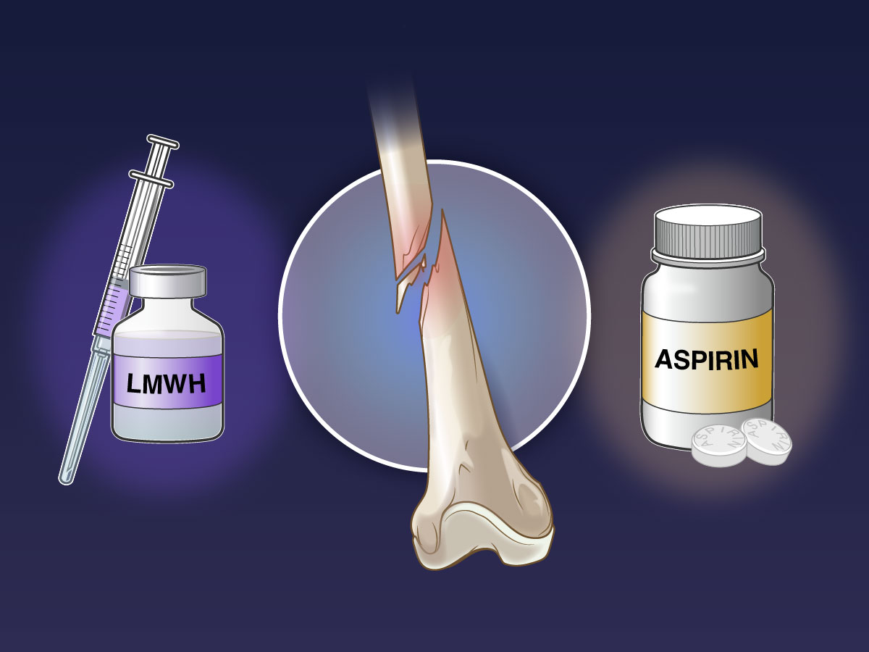
JOURNAL CLUB (Date: 30 Jan 2023)
Moderator | Presenter
Col. Y. Uday Professor Dept of Internal Medicine AFMC, Pune | Sqn Ldr Yashas Saipangallu Resident (JR-2) Dept of Internal Medicine AFMC, Pune

Slide 2
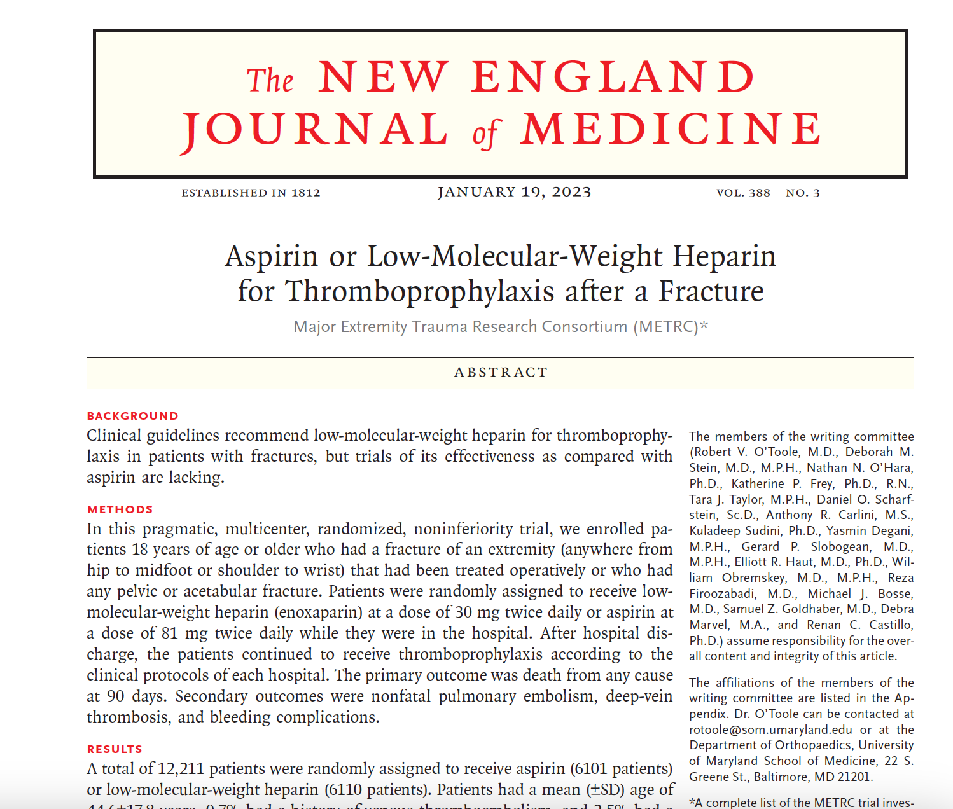

Slide 3
WHATS THE NEED OF STUDY?
Recent study by the Orthopaedic Trauma Association Evidence Based Quality Value And Safety Committee :
Highlighted “Knowledge Gap” surrounding the prevention of VTE in fracture patients.
Most current VTE prevention guidelines for orthopaedic trauma patients → Based on extrapolated data from arthroplasty patients/ elderly patients with isolated hip fractures.
  ‘Wide variability in practice patterns
  No large, high-quality trials on which to base these guidelines exist.

Slide 4
WHATS THE NEED?
Findings from recent trials and meta-analyses→ Aspirin may be an effective alternative to LMWH in patients who have undergone total joint arthroplasty
Evidence from head-to-head comparisons → Limited (# Patients)
If clinical outcomes are similar,
  Patients with fractures have shown a strong preference for aspirin
  Lower cost of Aspirin
  Oral administration
NOTE: Direct oral anticoagulants are also more costly than aspirin, making them less favourable from a patient perspective.

Slide 5
WHATS PREVENT-CLOT TRIAL?
Primary Objective:
  To compare Aspirin to LMWH for thromboprophylaxis in orthopaedic trauma patients.
  Hypothesis→ Aspirin is non-inferior to LMWH in preventing all-cause mortality within 90 days of randomisation.
Secondary Objective
  To compare the effects of Aspirin Vs LMWH in preventing cause specific mortality, non-fatal PE, DVT, bleeding complications, wound complications and deep surgical site infections (SSIs) within 90 days of randomisation.

Slide 6
METHODS: TRIAL AND DESIGN
PRINCIPAL INVESTIGATORS:
  The Department of Orthopedics at the University of Maryland School of Medicine
  Major Extremity Trauma Research Consortium Coordinating Center at the Johns Hopkins Bloomberg School of Public Health
    Oversaw data collection by research staff at the enrolling centers.
Multicentre (21 Centers), Randomised, Pragmatic Trial →To Compare LMWH Vs Aspirin for Thromboprophylaxis in Fracture Patients.

Slide 7
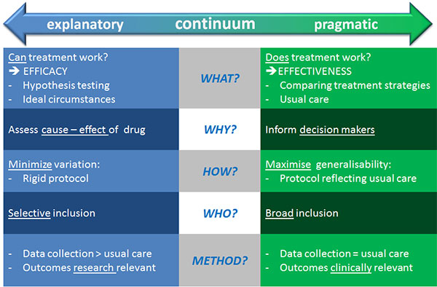
WHAT IS PREGMATIC TRIAL?
Introduced by Schwartz and Lellouch in 1967
Pragmatic Trial Purpose: Which treatment to use?
Explanatory Trial purpose: To answer a scientific question

Slide 8
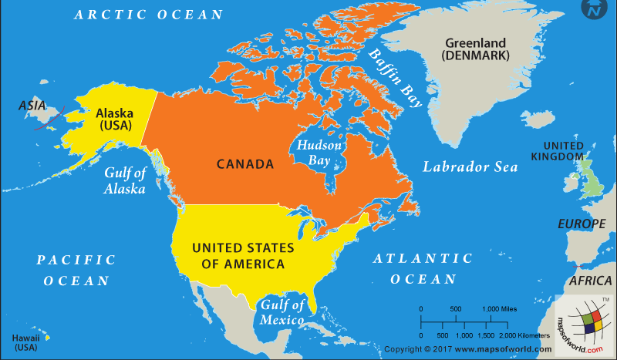
STUDY DESIGN AND METHODOLOGY
STUDY LOCATION: USA and CANADA→ Multicentric (21 centres)
STUDY PERIOD: April 2017- August 2021
SAMPLE SIZE: 12,200 fracture patients
Intension to treat approach
Primary outcomes→ Kaplan-Meier estimators
If non-inferiority criterion satisfied→ planned to test for superiority.

Slide 9
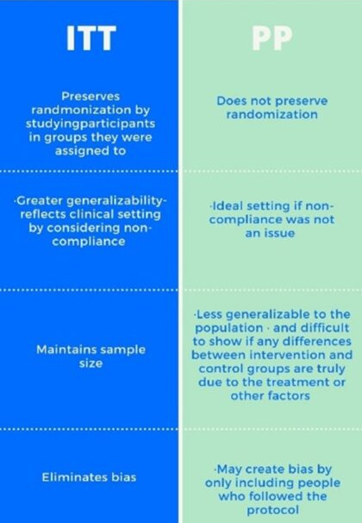
INTENTION TO TREAT APPROACH

Slide 10
WHAT IS NON INFERIORITY TRIAL?
TRIAL DESIGN | INTERPRETATIONS
Superiority | Aspirin > LMWH
Equivalence | Aspirin = LMWH “Aspirin is not unacceptably different compared to LMWH”
Non inferiority | Aspirin is not Un-accepatably worse than LMWH

Slide 11
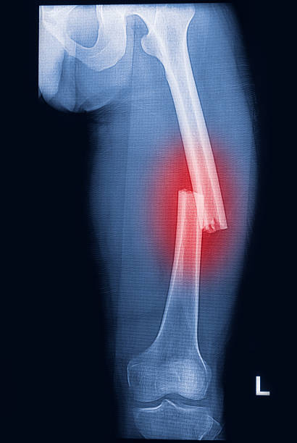
INCLUSION CRITERIA
Must be >=18 years of age
Have a planned operative or non-operative pelvis or acetabular fracture/ any operative extremity fracture
Fractures proximal to the metatarsals or carpals.
Patients will receive a VTE prophylactic regimen as per standard of care at the treating centre.

Slide 12
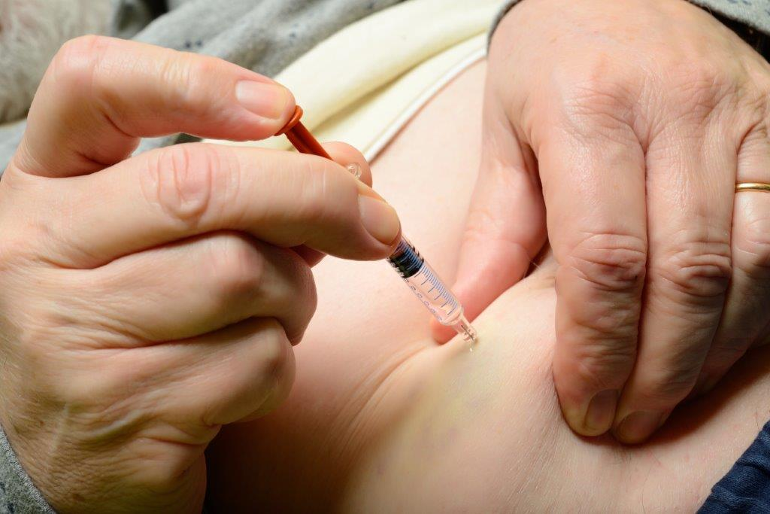
EXCLUSION CRITERIA
Present to the hospital more than 48 hours after injury.
Received >2 doses of LMWH or aspirin for initial VTE prophylaxis prior to consent.
Long-term anticoagulants.
Diagnosed with a VTE within the last 6 months.
Patients on therapeutic, as opposed to prophylactic, anticoagulants at the time of admission.

Slide 13
EXCLUSION CRITERIA
Diagnosed with an indication for therapeutic anticoagulants/ that will require therapeutic anticoagulation.
Allergy to Aspirin/ NSAIDs, or a history of HIT, or other medical contraindication to anticoagulants
Taking daily aspirin with a dose greater than 81 mg for medical reasons.
Have an underlying chronic clotting disorder that requires full dose anticoagulation or is a contraindication to VTE chemoprophylaxis.

Slide 14

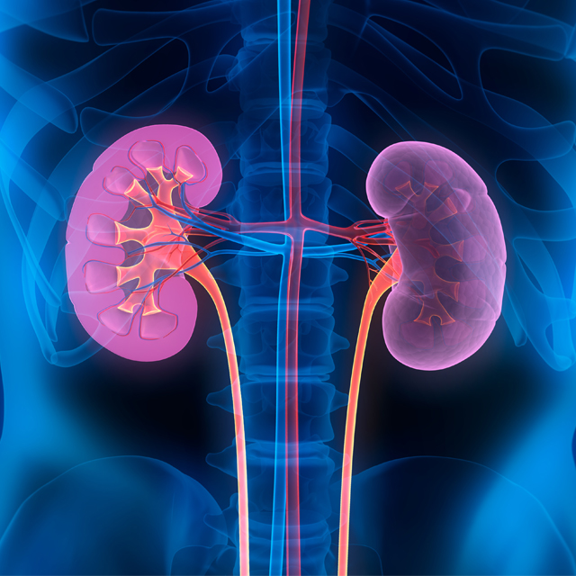

EXCLUSION CRITERIA
End-stage renal disease or impaired creatinine clearance of less than 30mL/min at the time of screening.
Pregnant or Lactating.
Speak neither English nor Spanish.
Are incarcerated.
Likely to have severe problems maintaining follow-up.
Diagnosis of COVID-19 at the time of fracture fixation or in the 3 months prior to fixation.

Slide 15
METHODS
BLINDING: NO
Treatment allocation was concealed during data monitoring and analysis
No consensus exists regarding the recommended duration/ exact indications for VTE
Duration and Indication for VTE Prophylaxis are determined by the VTE prophylaxis guidelines at each center.
TRAUMA
Evaluation for eligibility→ 2 doses of prophylaxis **
Duration of prophylaxis→ End at discharge/ continue as per hospital discharge policy
Consent
RANDOMISATION→ 1:1
REDCap (Research Electronic Data Capture System)
LMWH Arm: 30mg BD SC
Aspirin Arm:
81mg BD

Slide 16
PRIMARY OUTCOME
Death from any cause at 90 days:
Note: Primary Outcome was changed !!
  Initial primary outcome → Death related to pulmonary embolism
  Secondary outcome→ Death from any cause
    Concern regarding misclassification and competing risk with the outcome of cause-specific death

Slide 17
SECONDARY OUTCOME
EFFICACY OUTCOMES
Cause specific Death
  Related to PE
  Possibly related to PE
  Unlikely related to PE
Non fatal pulmonary embolism:
  Massive
  Submassive
  Clinically significant
  Asymptomatic→ No screening done
  Segmental/subsegmental
DVT
  Proximal
  Distal
SAFETY OUTCOMES
Bleeding events
  Bleeding into Organ
  Blood transfusion
  Drop in Hb 20g/L (2g/dl)
  Blood transfusion of >2 units
  Reoperation
Wound complications
Surgical site infections

Slide 18
RESULTS
Patients: 12211
Aspirin: 6101
LMWH: 6110

Slide 19
PROTOCOL ADHERANCE
 | ASPIRIN | LMWH
The mean hospital duration: 5.3-5.7 days.
Inpatient protocol-adherence | 5778 patients (94.7%) | 5291 patients (96.9%)
Mean number of inpatient doses of trial medication | 8.6 ± 10.8 | 9.1 ± 10.5
Discharge→ 91% the patients were receiving thromboprophylaxis | 93.6% | 88.8%
Discharge→ Median duration of thromboprophylaxis prescribed | 21 DAYS | 21 DAYS
Discharge→ Protocol-adherence criteria | 5760 patients (94.4%) | 5305 patients (86.6%)

Slide 20
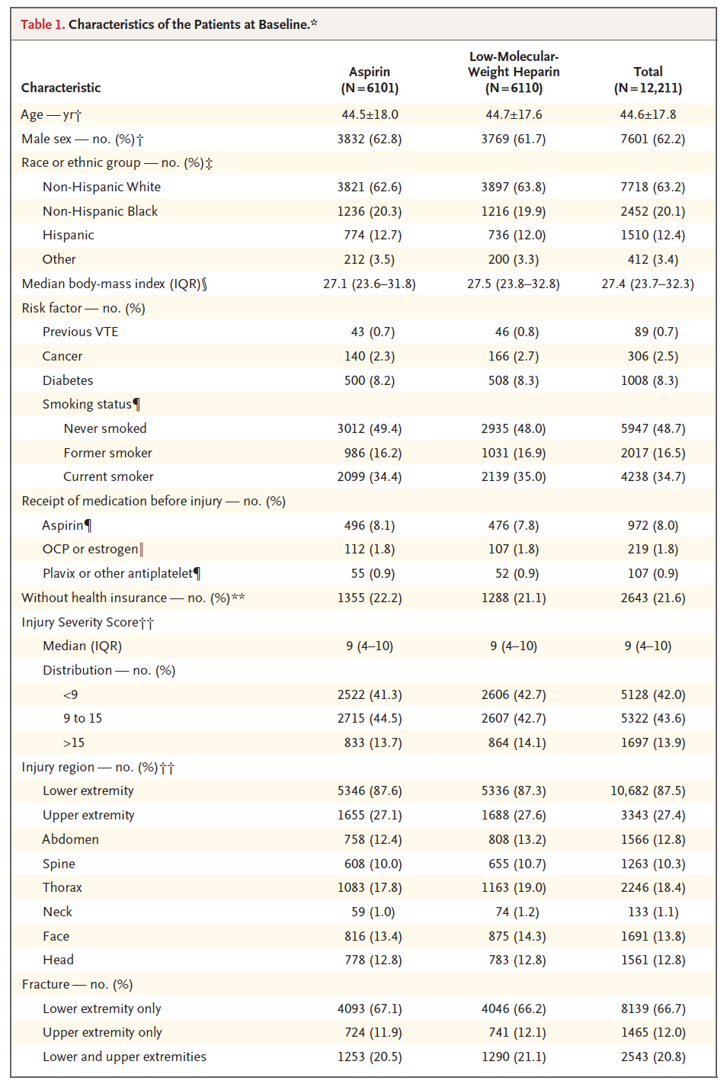

Slide 21
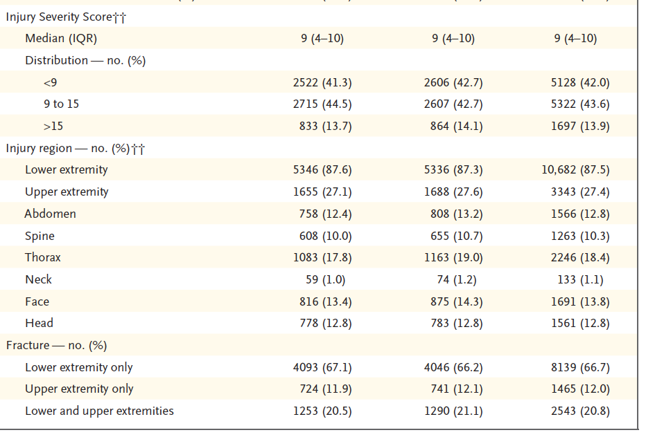
NOTE:
At the time of hospital
Discharge →
5447 patients (45.4%) were non–weight-bearing.
4373 patients (36.4%) were allowed to bear full weight on their injured extremities

Slide 22
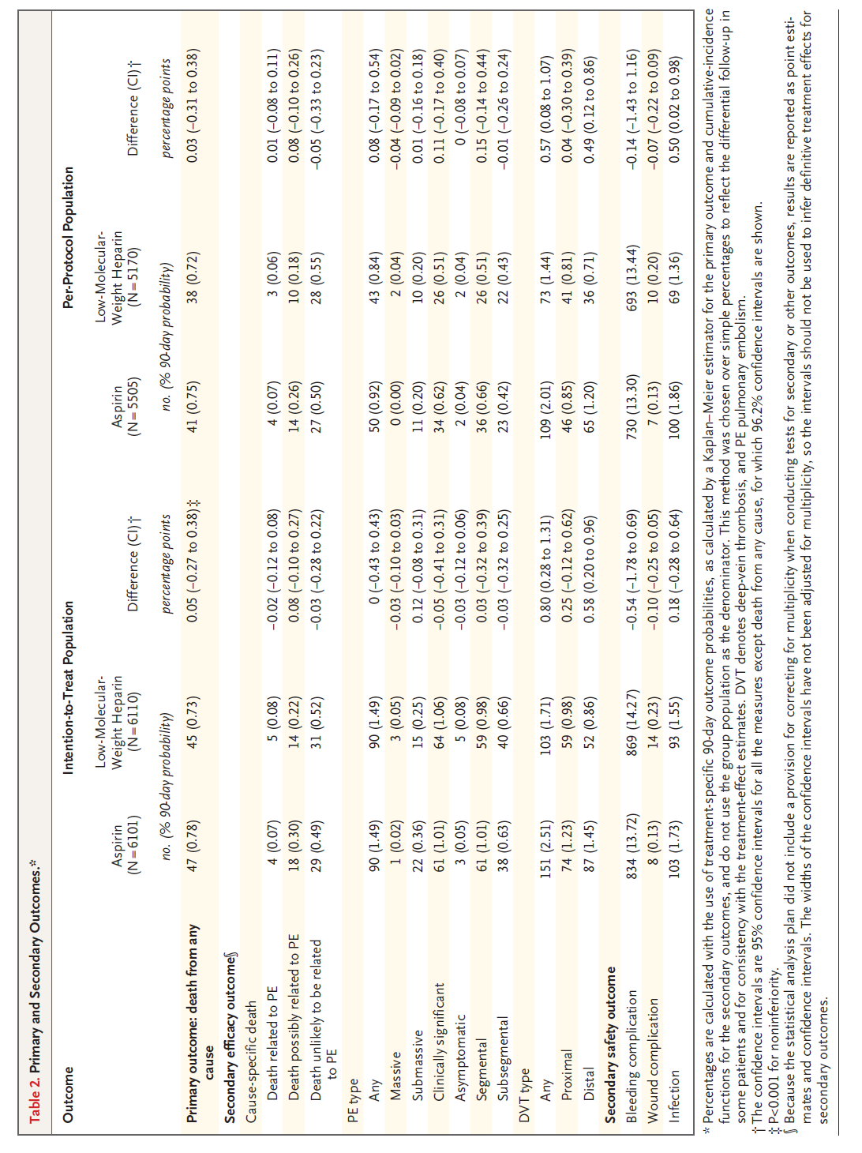
Aspirin was noninferior to LMWH (P<0.001) but not superior (P = 0.63) in preventing death from any cause.

Slide 23
NOTE:
Majority of nonfatal pulmonary embolisms took place within 7 days
Median time from randomization to the occurrence of deep vein thrombosis was 16 days

Slide 24
Note:
Median time to a bleeding event was 2 days after randomisation
The occurrence of other serious adverse events was similar in the two groups

Slide 25
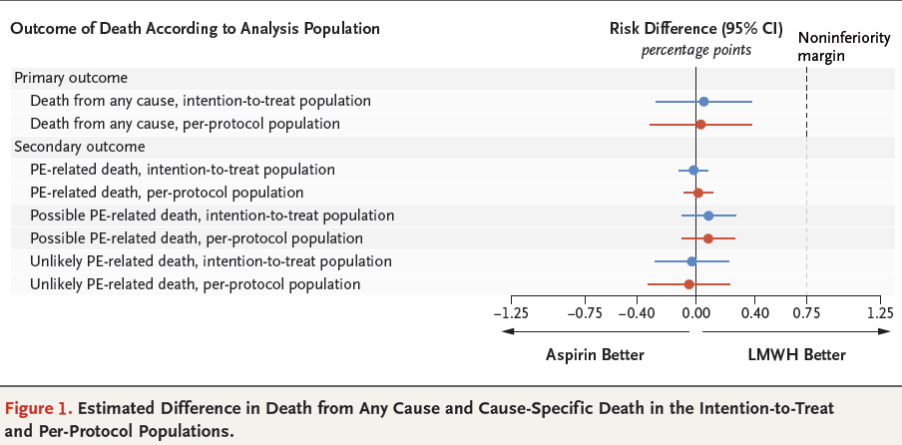
RESULTS

Slide 26
DISCUSSION
Thromboprophylaxis with Aspirin → Noninferior to LMWH for the prevention of death from any cause in fracture patients.
Result of pre-specified per-protocol analysis was consistent with primary intention-to-treat findings.
The findings of non-inferiority for Aspirin in the prevention of death from any cause was supported by consistent results with regard to the secondary outcomes.

Slide 27
DISCUSSION
Orthopedic trauma→ Only known risk factor for VTE in 25% of the patients
Results align with those from a previous trial
  Aspirin → Safe & Effective as LMWH in preventing thromboembolism after Orthopedic trauma

Slide 28
CONCLUSION OF THE STUDY
“In patients with extremity fractures that had been treated operatively or with any pelvic or acetabular fracture, thromboprophylaxis with aspirin was noninferior to LMWH in preventing death & associated with low incidences of DVT, PE and 90-day mortality”.
“No evidence of additional safety risks associated with Aspirin thromboprophylaxis in trial population”

Slide 29
CRITICAL APPRAISAL
TITLE
  Is it interesting?: YES
ABSTRACT
  Will the conclusions likely to be useful to you, in your area of clinical practice or research? YES
  Whether the settings in the material methods are similar to your own settings? YES

Slide 30
REFERENCE QUESTION
Is there a clear cut / specific research question? YES
Was it feasible for the authors to study this question given there with the technical expertise and available facilities? YES
Does the research question has some element of novelty? YES

Slide 31
VALIDITY
Have the authors made a mention of actual / study population? YES
Is the method of sampling been described? YES
Whether a mention of all the potential confounding factors been made? YES
Any selection or information bias could have been occurred? UNLIKELY

Slide 32


GATE Framework Assessment: PECOT
PARTICIPANTS : 12211
P
ASPIRIN: 6101
E
C
LMWH: 6110
To assess Death from any cause at 90 days
DURATION : April 2017- August 2021
O
T

Slide 33
ASSESSING VALIDITY

Slide 34
THE RAMMBO ACRONYM : ASSESSING STUDY BIAS
P
E
C
O
T
P
Recruitment
Allocation
Maintenance
Measurement of outcome
Blind or Objective
E
C
O
T

Slide 35
RAMMBO : RECRUITMENT
Study setting & eligibility criteria well described ? YES
Participants representative of eligible ? YES
Prognostic/risk profile appropriate to study question? YES
Randomization process described adequately? YES

Slide 36
RAMMbo: “A”: ALLOCATION
12211
1:1 ratio for baseline randomization
Randomization
ASPIRIN- 6101 LMWH - 6110
O

Slide 37
RAMMBO- MAINTENANCE
Good Maintenance ? YES
Did most participants remain in allocated groups ? YES
Participants &/or investigators blind to exposure (and comparison exposure)? NO
Compliance high & similar in EG &CG? YES
Completeness of follow-up high & similar in EG &CG? YES
O

Slide 38
RAMMbo
P
Measurement of outcomes
blind or objective? BLIND (Adjudicators)
EG CG
Authors reviewed all results: YES
O
T

Slide 39
Recruitment
Bias: NO
P
Allocation : Adequate
E C
Maintenance: High Retention
O
Measurement : Right Statistical tools (of outcomes)
T

Slide 40
STRENGTH OF THE STUDY
Findings are clinically meaningful.
Trial was performed at 21 centres with high follow-up (96.8%) and adherence (87.4%)→ Large population
Head to head clinical trial
Adjudication committee members were unaware of trial-group assignments
  Reviewed all outcomes of death and PE → Further verified the reliability of findings.

Slide 41
LIMITATIONS
Study→ Not blinded
Allowed patients to receive→ two doses of LMWH/Aspirin as standard care before randomisation
  Aspirin & LMWH have different half lives
Trial was open-label design→
  potential for diagnostic suspicion / surveillance bias in secondary outcomes

Slide 42
LIMITATIONS
Pragmatic Trial Design: Variability in clinical guidelines for the duration of thromboprophylaxis at different institutions
  Differences in the duration of therapy after discharge → Influence on outcomes.
Primary outcome was changed →
  Death related to pulmonary embolism → Death from any cause
  (after enrolment began)
Not studied in heterogenous populations

