Slide 1
JOURNAL CLUB
Hepatocellular Carcinoma risk in patients with chronic Hepatitis B receiving Tenofovir vs Entecavir based regimens: Individual patient data meta analysis
Presenter- Maj Abhishek Aravind
Moderator- Col Manish Manrai

Slide 2
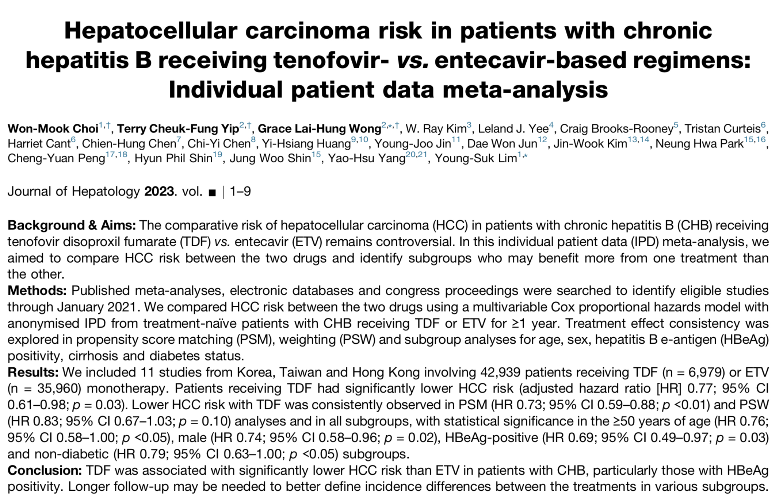

Slide 3
Aim
To compare the risk of developing HCC between the patients receiving TDF vs ETV based monotherapies by Individual Patient Data Meta-analysis

Slide 4
Methods
Published Meta-analyses, electronic databases and congress proceedings searched in Jan 2021
Compared HCC risk between two groups using Multi-variable Cox proportional Hazards model
Treatment effect consistency expored in Propensity score matching, weighting and sub group analyses

Slide 5
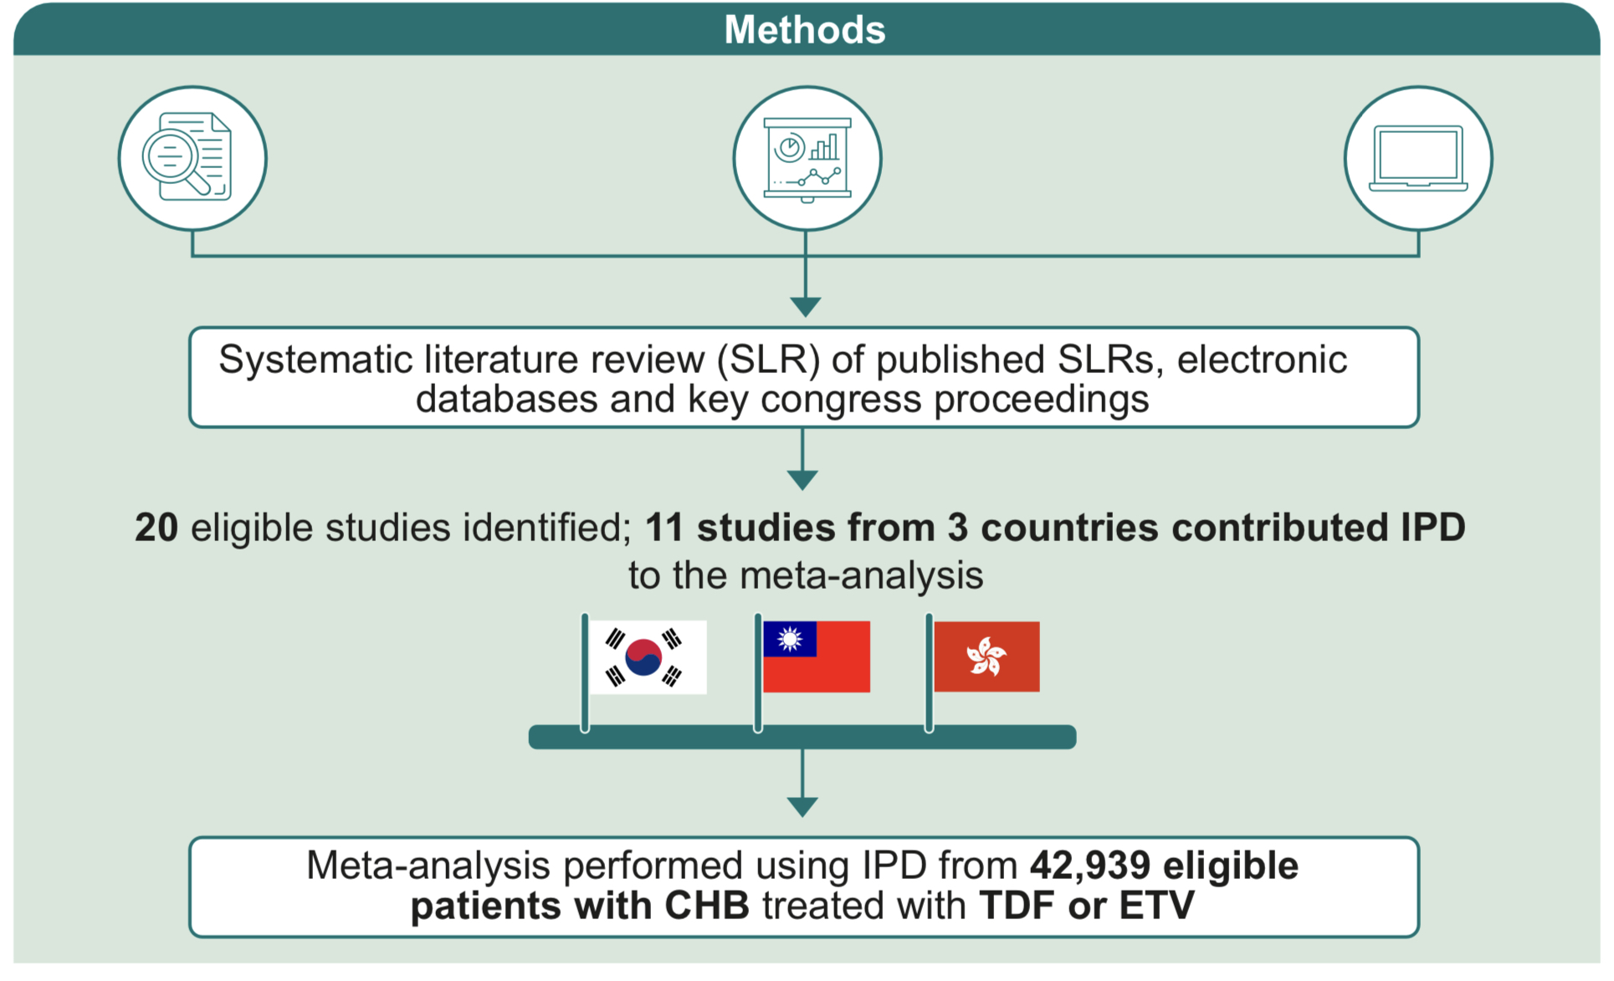
METHODS

Slide 6
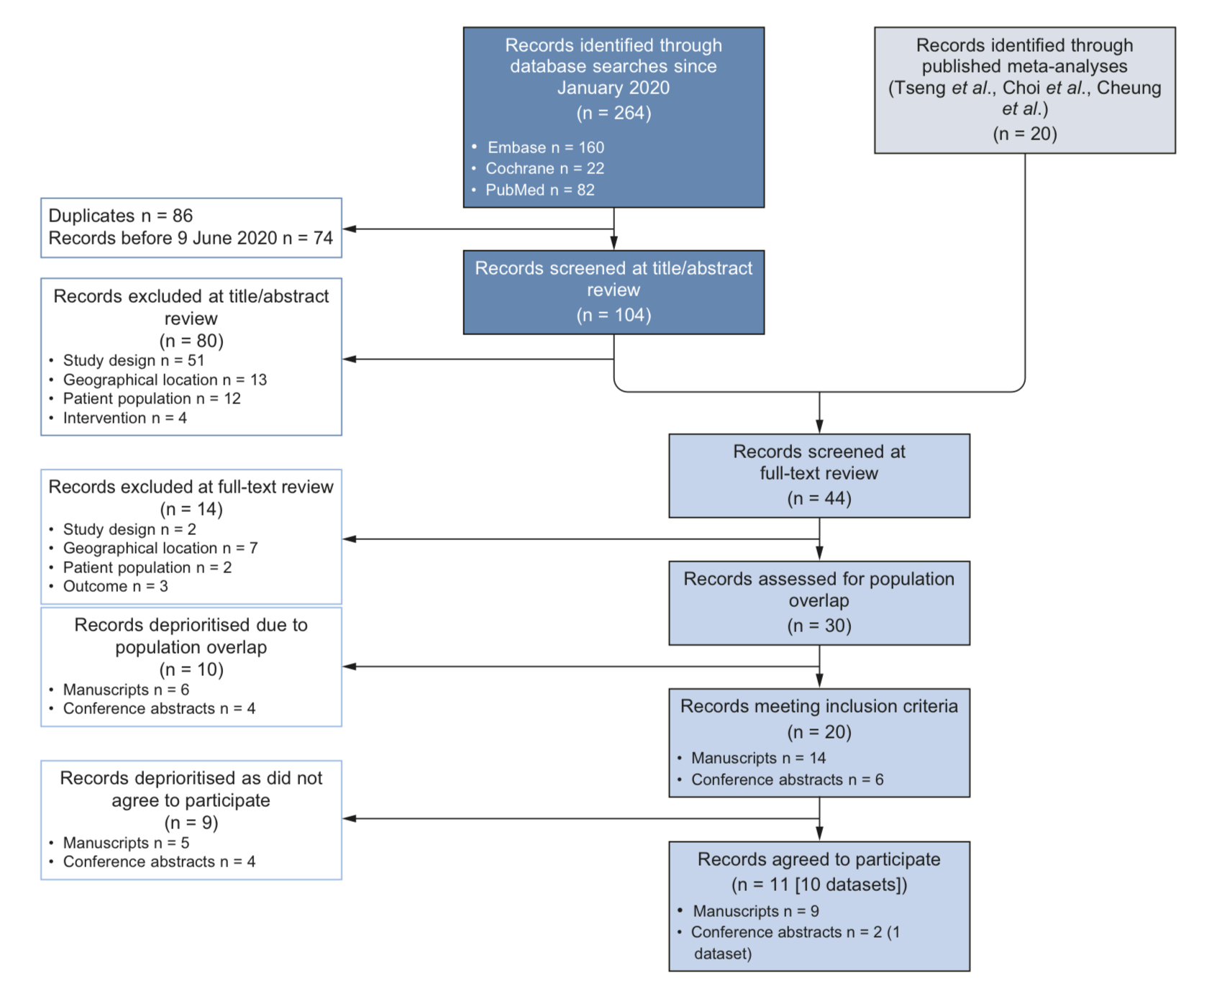

Slide 7
Study Eligibility Criteria
Inclusion criteria
Study design- Prospective/retrospective cohort study, Case control study or RCT
Population- Patients with CHB
Treatment- Studies of ETV and TDF monotherapies
Outcome- Risk of HCC presented as a primary or secondary outcome
Study location- East Asia including China, Hong Kong, Japan, South Korea and Taiwan
Sufficient variable/outcome availability- Variables deemed necessary to apply patient-level inclusion/ exclusion criteria or that are required for Propensity score matching must be available

Slide 8
Study Eligibility Criteria
Exclusion Criteria
Study design- Review articles, meta-analyses, editorials, case reports
Population overlap- If multiple studies reported the same populations with overlapping patient recruitment dates, the most recent or informative study was chosen by considering the duration of follow-up and study sample size
Claims databases- Claims/ administrative databases were excluded
Selected cohort- HBeAg negative populations at baseline
Patient population- studies with patient population restricted to treatment –experienced, liver transplant, HCC in the past or at baseline, and or co-infected with HIV, HCV or Hepatitis D Virus were considered ineligible

Slide 9
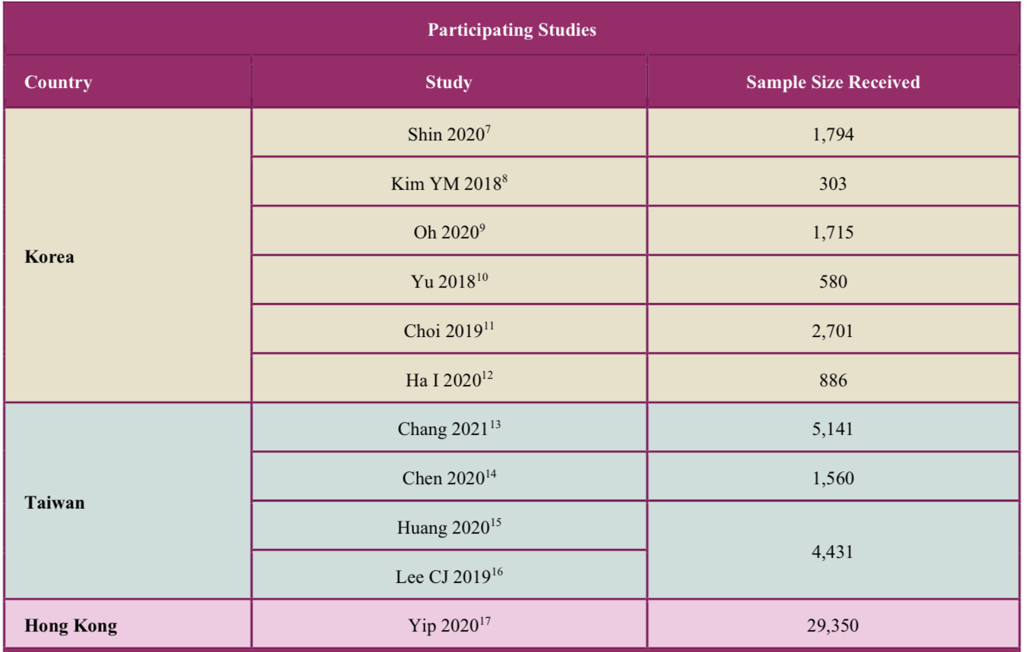
Participating studies

Slide 10
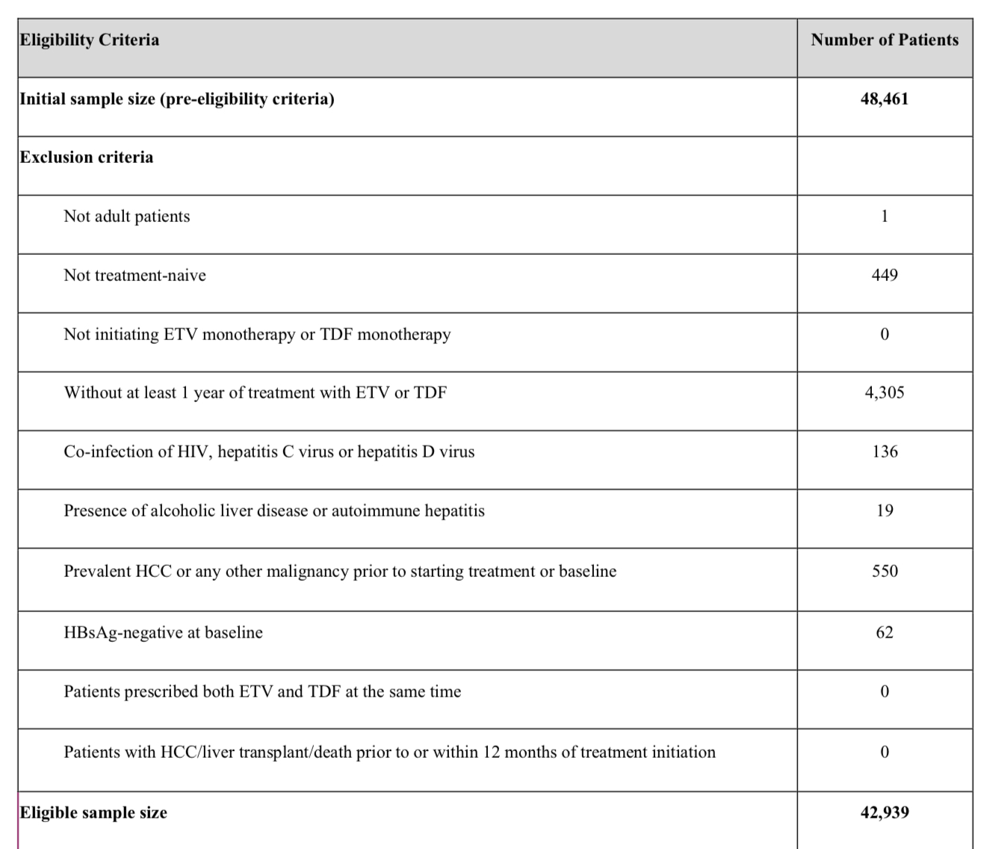
Patient eligibility criteria

Slide 11
Result
Using IPD of 42,939 patients from 11 studies in 3 countries
TDF associated with significantly reduced HCC risk compared with ETV in patients with CHB
Sensitivity analysis consistent with results

Slide 12
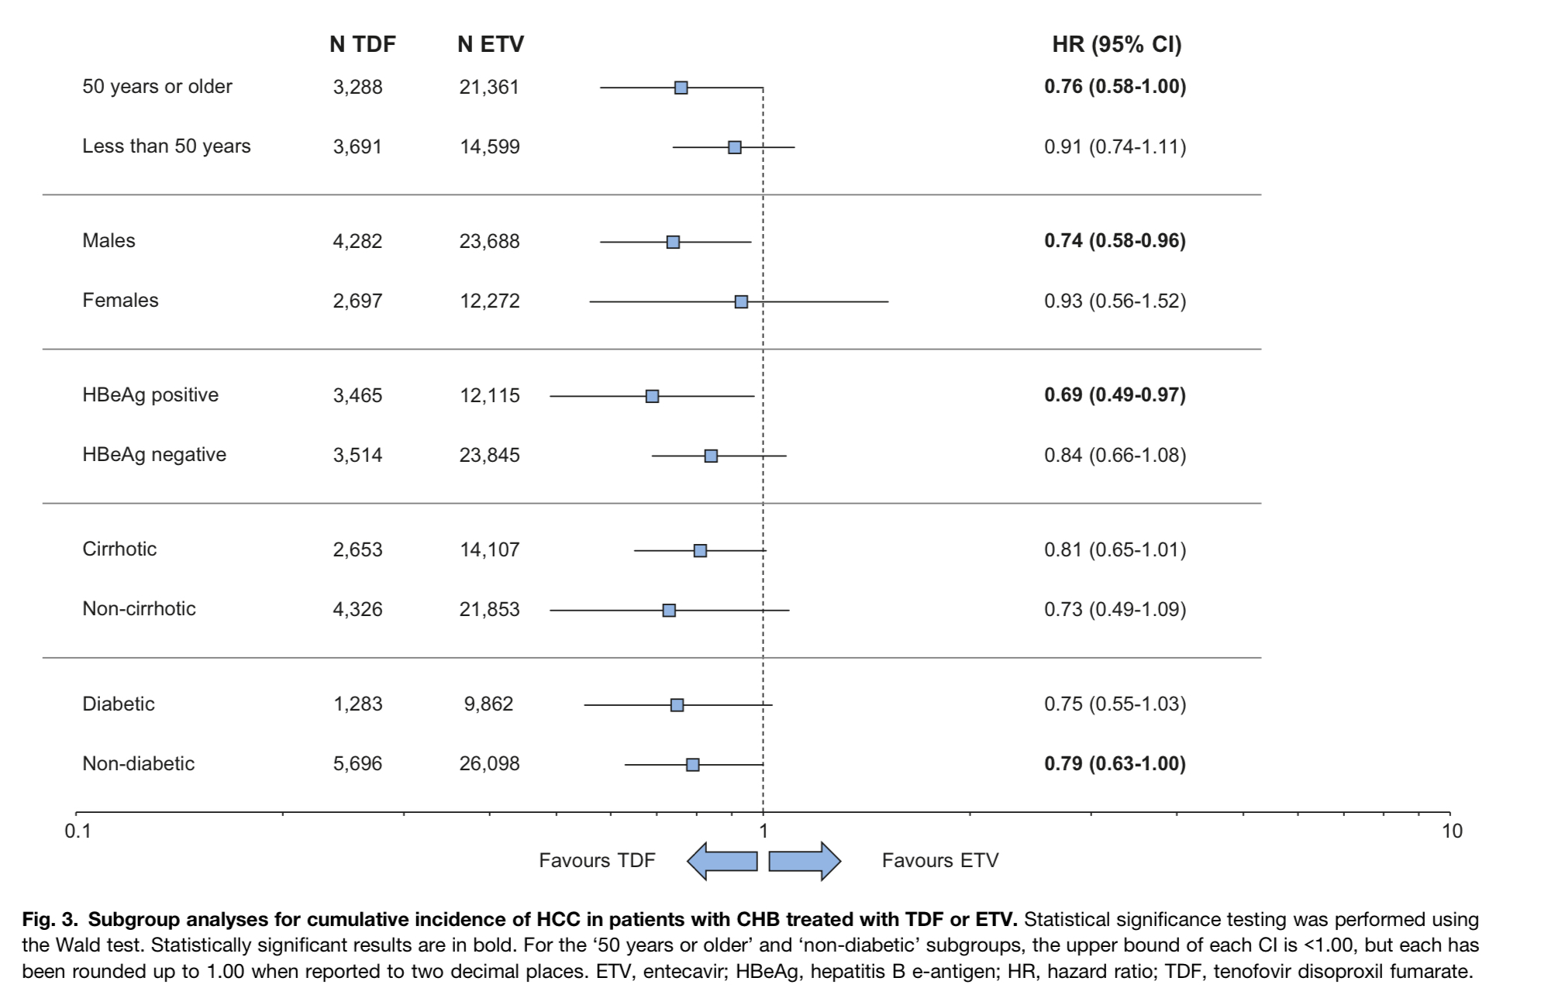
Statistical Analysis

Slide 13
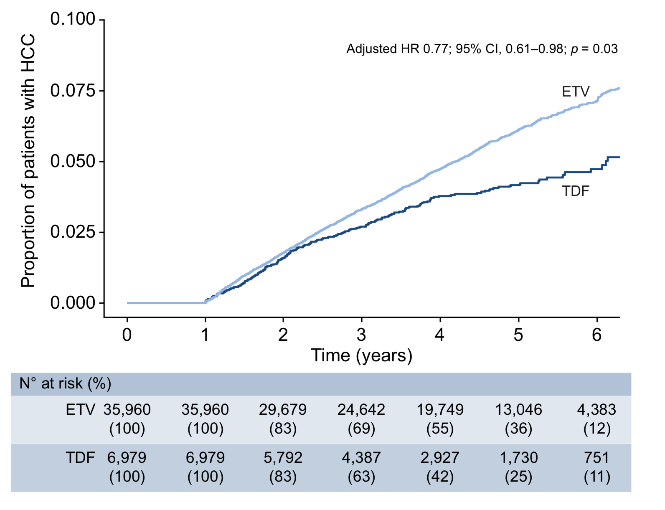
Statistical Analysis

Slide 14
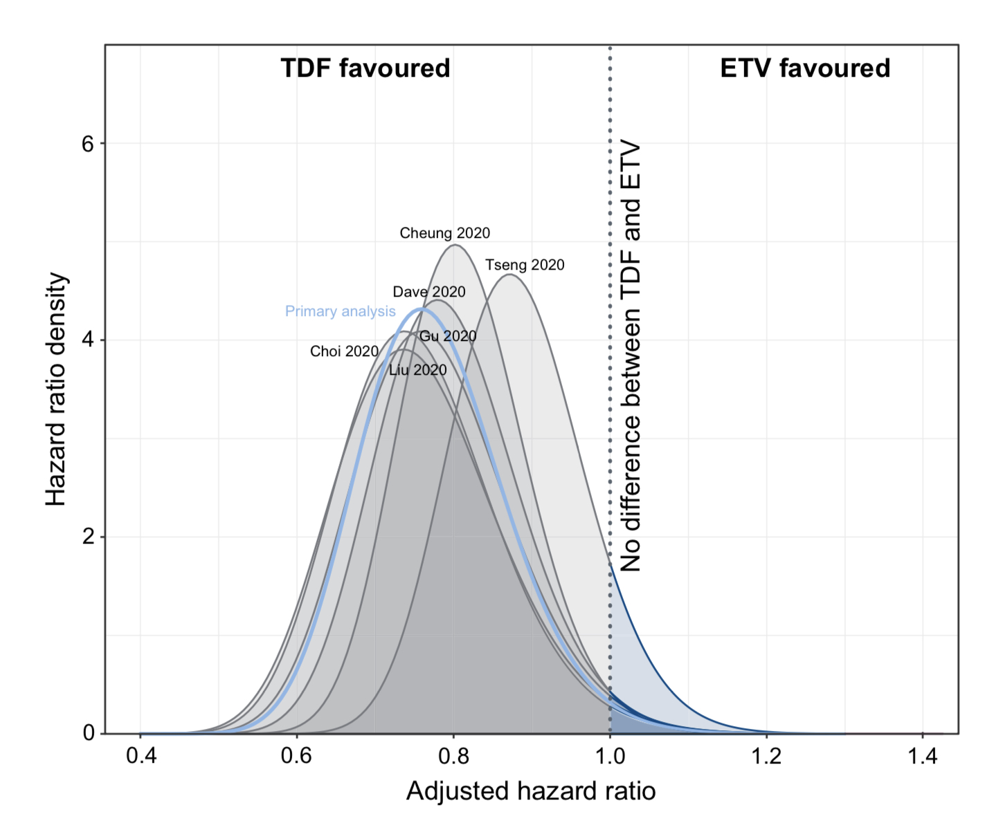
Comparison with other Meta-analyses

Slide 15
CRITICAL APPRAISAL
TITLE
  Is it interesting? YES
ABSTRACT
  Will the conclusions (if valid), likely to be useful to you, in your area of clinical practice or research? YES
  Whether the settings in the material methods are similar to our own settings? YES

Slide 16
REFERENCE QUESTION
Is there a clear cut / specific research question? YES
Was it feasible for the authors to study this question given there technical expertise and available facilities? YES
Does the research question has some element of
novelty? YES

Slide 17
VALIDITY
Have the authors made a mention of Actual / Study Population ? YES
Is the method of sampling been described? YES
Whether a mention of all the potential confounding factors been made? YES
Any selection or information bias could have occurred? Possible

Slide 18



GATE Framework Assessment : PECOT
PARTICIPANTS: 42,939
P
TDF Group: 6,979
ETV Group: 35,960
OUTCOME: Development of HCC
O
DURATION : Jan 2011 to 05 Dec 2019
T

Slide 19
The RAMMbo acronym : Assessing study bias
P
E
C
O
T
P
Recruitment
Allocation
Maintenance
Measurement of outcome
Blind or Objective
E
C
O

Slide 20
RAMMbo : Recruitment
Study setting & eligibility criteria well described ? YES
Participants representative of eligible ? YES
Prognostic/risk profile appropriate to study question? YES
Randomization process described adequately? YES

Slide 21
RAMMbo: A is for Allocation
42939
E-6979 C-35,960
1:5 ratio for baseline randomization
O
T

Slide 22
RAMMbo: Maintenance
Good Maintenance ?
Did most participants remain in allocated groups ? Yes
Participants &/or investigators blind to exposure
(and comparison exposure)? Yes
Compliance high & similar in both group? Yes
Completeness of follow-up high & similar in both group?
Yes
O

Slide 23
RAMMbo: Measurement
EG CG
Outcome measurements were Objective
Authors reviewed all results
O

Slide 24
RAMMBO
Recruitment
Bias: No bias
P
Allocation : Adequate
E C
Maintenance: High Retention
Measurement : Right Statistical tools
(of outcomes)
O
T

Slide 25
STRENGTHS
Large scale study
Participants literate and exhibit more positive health behaviour
Decentralised

Slide 26
LIMITATIONS
Differences in follow up time between TDF and ETV patients could n ot be fully accounted for and may confound the results
Underlying data collection methodologies and definitions used across the studies could not be aligned
No adjustments for multiple testing was performed
Only half of identified studies agreed to participate, which may have led to selection bias
All included studies were from East Asia, so results may not be generalizable to the global CHB population

Slide 27
CONCLUSION
TDF was associated with significantly lower HCC risk than ETV in patients with CHB
Particularly n those with HBeAg positivity
Longer follow-up may be needed to better define incidence differences between the treatments in various subgroups

