Slide 1

JOURNAL CLUB
Presented by : Sqn Ldr Pillai Jayakrishnan S, Resident Medicine
Moderated by: Wg Cdr Rohit Vashisht, Cl Splt Med & ID Specialist

Slide 2
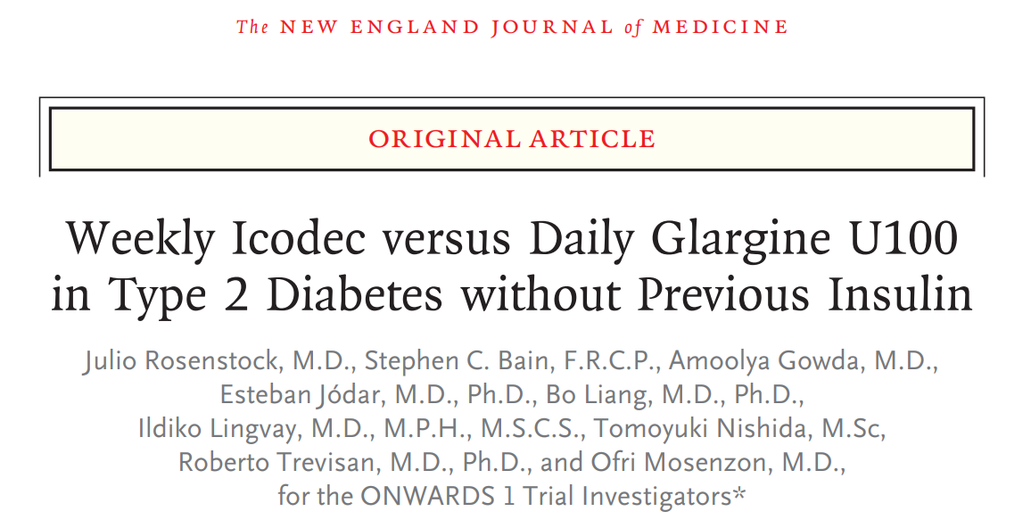

Slide 3
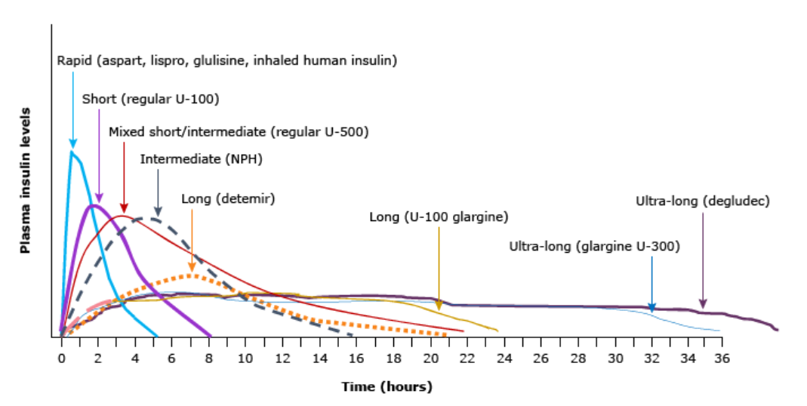
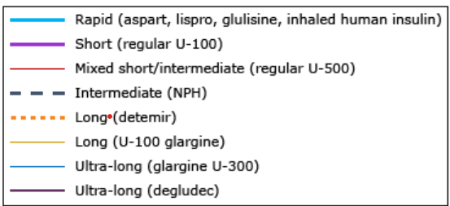
Pharmacokinetic profile of insulins

Slide 4
Icodec
3 molecular modifications underlying longer half life
3 amino acid substitution prevent enzymatic degradation, ensure stability and solubility
Addition of a C20 fatty di-acid imparts strong and reversible binding
All modifications contribute to slow receptor mediated clearance
Interact with same insulin receptors to activate the same signalling pathway to give same full metabolic effects as human insulin.

Slide 5
Icodec
Icodec does not demonstrate increased binding to the IGF receptor and has low mitogenic potency
Gradual continuous release of Icodec from the albumin bound depot leads to prolonged action
Slow release of the albumin bound icodec, combined with slow receptor activation is expected to buffer against dose variations.
Equivalent dose per unit compared to Glargine

Slide 6
Need for this trial
Management of Type 2 Diabetes – Stepwise approach
Injectable treatments
Incretin based therapies – first line injectable treatments
Initiation of once or twice daily basal insulin analogues – common strategy
Concerns – Suboptimal glycaemic control:
Daily injections
Reduced treatment adherence
Patient preference – fewer injections

Slide 7
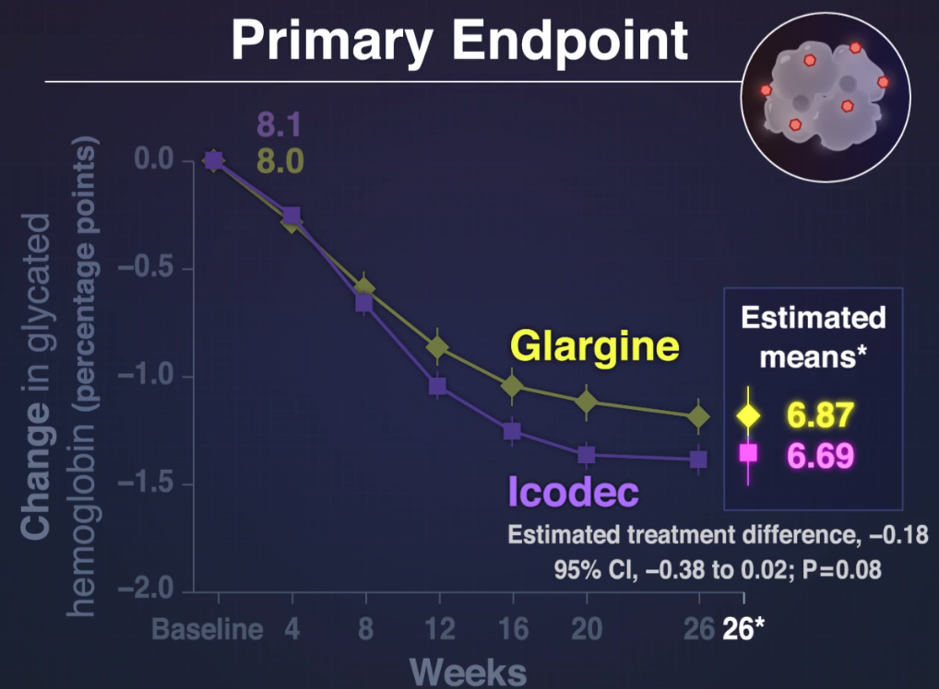
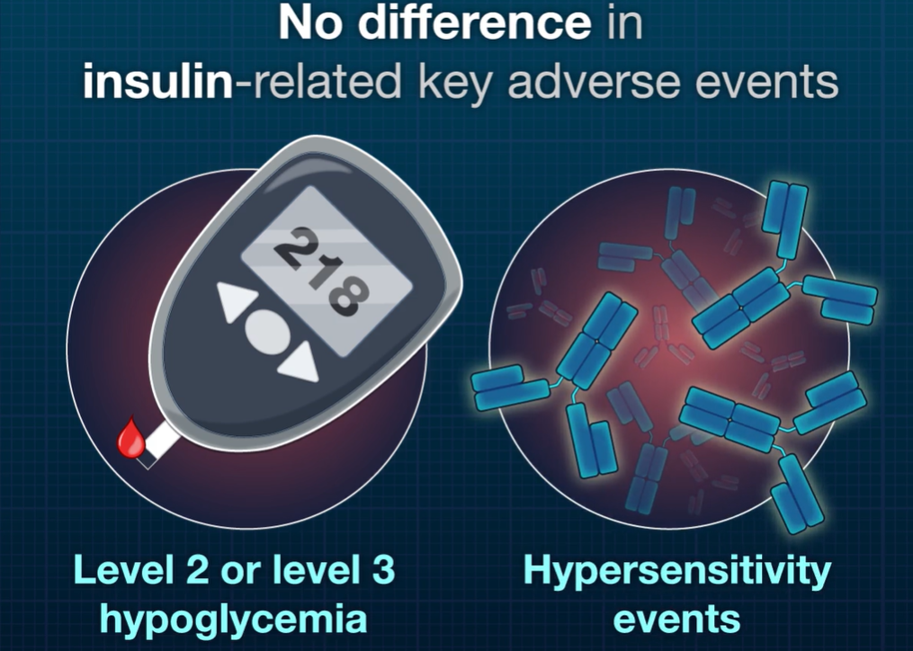
Background
Insulin icodec is an investigational once weekly basal insulin analogue for management of Diabetes Mellitus Type 2 with a single subcutaneous injection
Notes:
Phase 2 trial published in 2020 26 week

Slide 8
ONWARDS Trial series
TRIAL | CATEGORY | DESCRIPTION |  |  |  | Remarks
 |  | Open/ blind | Duration | Study drug | Comparator
ONWARDS 1 | T2DM who did not receive insulin previously | Open | 78 wk | Icodec | Glargine U100 | Phase 3a Target to treat
ONWARDS 3 |  | Double blind | 26 wk | Icodec | Degludec | Phase 3a Target to treat, non inferiority
ONWARDS 5 |  | Open label | 52 wk | Icodec | Glargine U100/ U300 | Real world elements, dosing guide

Slide 9
ONWARDS Trial series
TRIAL | CATEGORY | DESCRIPTION |  |  |  | Remarks
 |  | Open/ blind | Duration | Study drug | Comparator
ONWARDS 2 | T2DM received insulin previously |  | 26 wk | Icodec | Degludec | Phase 3a
ONWARDS 4 |  | Double blind, double dummy | 26 wk | Icodec | Glargine + Prandial | Phase 3a Basal bolus vs Icodec
ONWARDS 6 | Type 1 Diabetes mellitus – insulin naïve | Open label | 52 wk | Icodec | Degludec + Prandial Aspart | Treat to target Phase 3a

Slide 10
Primary Objective
To demonstrate the effect on glycaemic control of once weekly insulin icodec in comparison to once daily insulin glargine U100, both in combination with non insulin antidiabetic drugs in insulin naïve subjects with Type 2 Diabetes Mellitus

Slide 11
Secondary Objective
To compare the parameters of glycaemic control and safety of once weekly insulin icodec with once daily insulin glargine, both in comparison with non insulin anti diabetic drugs, in insulin naïve subjects with Type 2 Diabetes Mellitus

Slide 12
Study Design
78 week duration
Randomised
Open label
Parallel group, active control
Multicentre
Multinational
Treat to target
Phase 3a trial

Slide 13
Detail about the study
Parameter | Answer
Duration of study | 85 weeks (overall)
Centres | 143 centres
Countries | 12 countries
Randomisation | 1:1 by Interactive web response system
Trial Arm | Icodec (700 U/ ml) Novo Nordisk
Control Arm | Glargine U100 (100 U/ ml) Sanofi Aventis
Mode of delivery | Prefilled pen injector – subcutaneous
Funding | Novo Nordisk

Slide 14
Study design
Duration 85 weeks
Screening
02 week
Randomised treatment period 78 week
Follow up
05 week
Main
52 week
Extension
26 week
Assess primary and secondary endpoint analysis
Evaluate
Long term safety

Slide 15
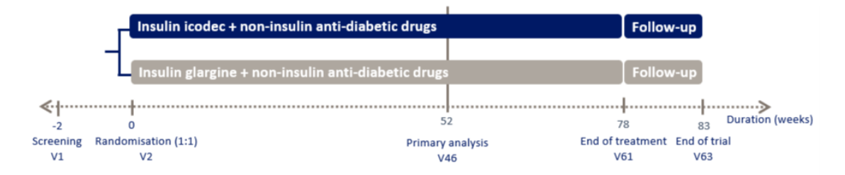
Timeline

Slide 16
Primary and secondary endpoints
 | End point title | Time frame | Unit
Primary endpoint | Change in HbA1C | From baseline week 0 to week 52 | % point
Secondary endpoint | Time in target range 70 to 180 mg/dl (using CGM) | From week 48 to week 52 | % of readings

Slide 17
Methodology
Fulfilled inclusion criteria
Screening
Randomisation
Once daily Glargine U100
Once weekly Icodec 700U/ml
Starting dose - 10 U/day
Starting dose - 70 U/day
Treat to target (Pre breakfast SMBG target: 80 – 130 mg/dl)
Continue pre trial non insulin GLA – Except Sulphonylureas and Glinides
Accu-Chek Blood glucose monitor
For treat to target
and titration
Bluetooth linked e Diary to cloud
Double blind CGM Dexcom G6
Participant and investigator blind, Data to evaluate glucose metrics and
not for insulin titration
Education on using device

Slide 18
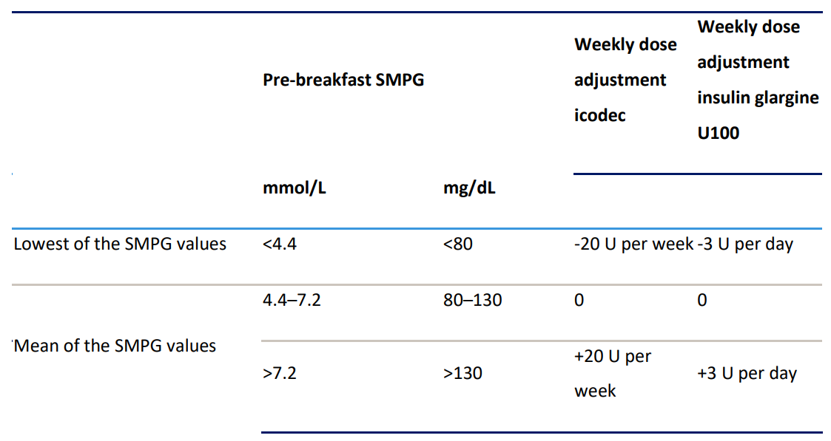
Titration target and dose adjustment

Slide 19
Inclusion Criteria
Adult ≥ 18 years at the time of signing the informed consent
Diagnosed Type 2 Diabetes Mellitus ≥ 180 days prior to screening day
HbA1C level: 7.0 – 11.0% (central laboratory)
Insulin naïve (Exc: short 14 d insulin prior and insulin in GDM)
Stable daily doses ≥ 90 days prior to screening of any non insulin GLA or combination regimen.
BMI ≤ 40.0 kg/m²
Notes:
Insulin naïve, though short term insulin treatment for a maximum of 14 days prior to the day of screening was allowed, as is prior insulin treatment for GDM.

Slide 20
Exclusion Criteria
Known or suspected hypersensitivity to the trial product or related products.
Previous participation in this trial
Pregnancy, Breastfeeding, intends to become pregnant or of child bearing potential not using an adequate contraception method
Participation in any clinical trial of an approved or non approved investigational medicinal product within 90 d of screening

Slide 21
Exclusion Criteria
Any DKA within 90 days prior to screening
MI, Stroke, hospitalisation of UA, TIA within 180 days prior to day of screening
Any comorbidity which in investigator’s opinion can jeopardise participant safety or protocol
CHF NYHA IV
Planned coronary, carotid revascularisation
Renal impairment with eGFR< 30 ml/min/1.73 m²
Untreated SBP ≥180 mm Hg or DBP ≥ 110 mm Hg at screening
Notes:
What if the lady enrolled conceives during the study?
What if the patient cant be positioned for a PA view? Excluded

Slide 22
Exclusion Criteria
Treatment with any medication for DM or obesity other than ones in inclusion criteria within 90 days prior to screening
Unstable diabetic retinopathy or maculopathy (Fundus examination within past 90 days or before randomisation)
Presence or history of malignant neoplasm within 5 years prior to day of screening
Anticipated change in lifestyle affecting glucose control

Slide 23
Safety assessment
Level of Hypoglycaemia | Alert value
Hypoglycaemia Level 1 | Glucose level 54 – 70 mg/ dl | Fast acting carbohydrate and dose adjustment of GLA
Hypoglycaemia Level 2 | Glucose value < 54 mg/dl | Serious clinically important hypoglycaemia
Hypoglycaemia Level 3 | No threshold | Severe cognitive impairment that required external assistance for recovery

Slide 24
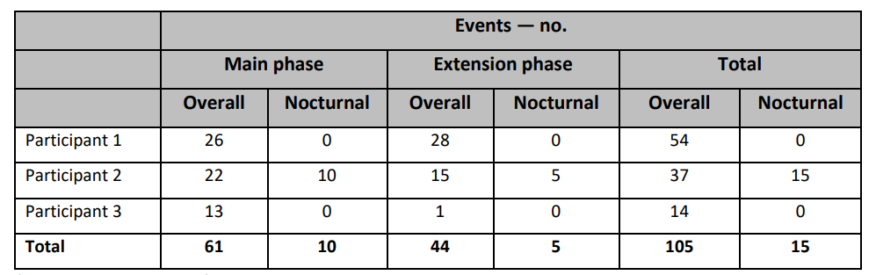
Clinically Significant hypoglycaemia
3 participants in the icodec treatment arm had experienced more than 10 clinically significant level 2 hypoglycaemic events over the course of trial.
No participant in Glargine arm had more than 10 clinically significant level 2 hypoglycaemic events over the course of trial

Slide 25
Hierarchical testing
Primary Hypothesis
Icodec is non inferior to Glargine U100 w.r.t change in HbA1C from baseline to 52 weeks
Non inferiority confirmed in primary analysis
Secondary hypothesis
Icodec is superior to glargine w.r.t TIR 70 – 180 mg/dl from week 48 - 52
Icodec is superior to glargine in terms of change from baseline to week 52 in A1C

Slide 26
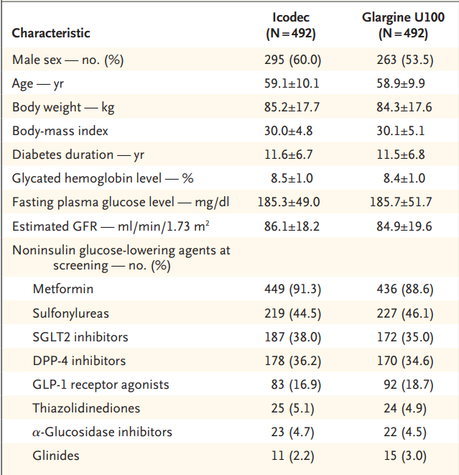
Demographic characteristic of participants
Notes:
The global prevalence of T2D is slightly higher in men and prevalence increases with age. Ethnic groups – Asian, Hispanic and Blacks have higher prevalence. Individuals with higher BMI are more likely to develop DM2. Participant sample in this trial is largely representative of the clinical settings with slightly more men than women included and a mean age of 59 yeas. Oberved BMI in this study was approximately 30 kg/m2 across the treatment arms. Countries included are those where DM 2 show highest prevalence

Slide 27
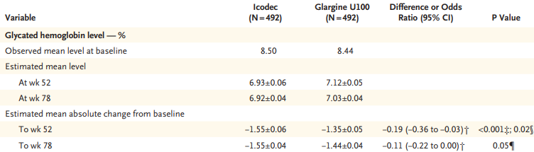

Efficacy findings

Slide 28
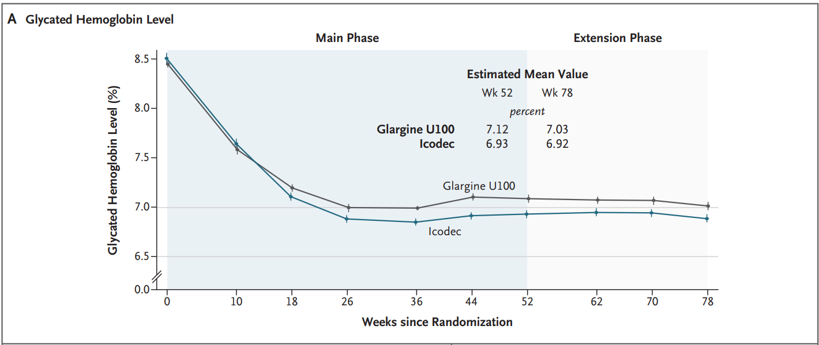
Key end points
Multiple imputation
Mean Glycated Haemoglobin levels from baseline to week 78 ICODEC vs GLARGINE U 100

Slide 29
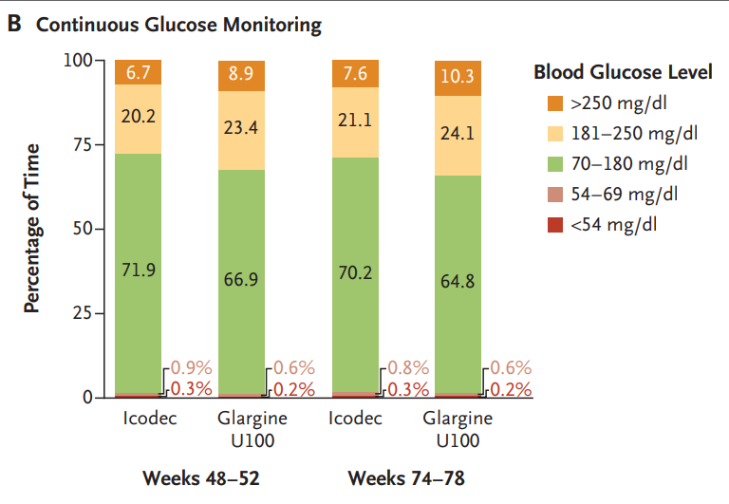
Key end point
Percentage of time spent in various glucose levels in weeks 48 – 52 &
weeks 74 – 78 as measured by CGM

Slide 30
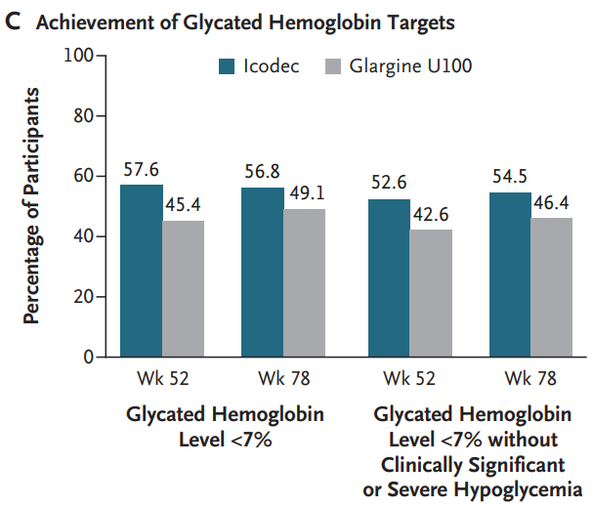
Key end point
Percentage of participants who reached HbA1C < 7 and those without hypoglycaemia

Slide 31
Results
 | ICODEC | GLARGINE U 100
Estimated HbA1C reduction | Significantly better
Reduction in HbA1C | Sustained with Icodec
Time spent in target glycaemic range | Significantly more compared to glargine (61 min/day)
Mean weekly insulin dose | 214 U per week | 222 unit/ week
Changes in weight | 2.29 kg | 1.83 kg (No substantial difference)
Clinically significant hypoglycaemic events | 226 events (3 contributed – 105) 61 participants | 114 events 66 participants
Severe hypoglycaemia | 1 episode | 7 episodes
Hypoglycemia rates | < 1 event per person year of exposure at trial completion
Adverse events | 95/64 (not trial related) | 119/71

Slide 32
Critical appraisal

Slide 33
Title and Abstract
Title
Is it interesting ? | Yes
Abstract
Will the conclusions (if valid) likely to be useful to you, in your area of clinical practice of research? | Yes
Whether the settings in the material methods are similar to our own settings? | Yes
Notes:
Yes, in fact, the Cochrane meta analysis of 10 such randomised trials done which verified similar reduction in surgical intervention

Slide 34
Research question
Research Question
Is there a clear cut/ specific research question? | Yes
Was it feasible for the authors to study this question, given that there are technical expertise and available facilities? | Yes
Does the research question have some element of novelty? | Yes

Slide 35
Validity
Validity
Have the authors made a mention of Actual/ Study Population ? | Yes
Is the method of sampling been described ? | No
Whether a mention of all the potential confounding factors been made ? | Yes
Any Selection or information bias could have occurred ? | Yes

Slide 36
Gate Frame Assessment : PECOT
PARTICIPANTS : 984
P
E
C
EXPOSURE GROUP : 492
COMPARISON GROUP: 492
OUTCOME: Absolute change in HbA1C in percentage from baseline to week 52
O
T
DURATION: 78 week (85)

Slide 37
Assessing study bias: The RAMMbo acronym

Slide 38
Assessing Study Bias
R
Recruitment
A
Allocation
M
Maintenance
B
Blind
M
O
Objective measurement

Slide 39
Recruitment
Recruitment
Study setting and eligibility criteria well described | Yes
Participants representative of eligible? | Yes
Prognostic/ risk profile appropriate to study question? | Yes
Randomisation process described adequately | Yes

Slide 40
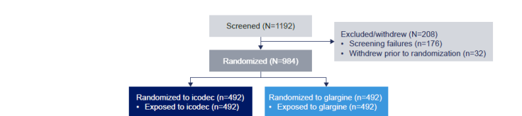
Allocation

Slide 41
Maintenance
Maintenance
Good maintenance | Yes
Did most of the participants remain in the allocated groups? | Yes
Participants and/ or investigators blind to exposure (and comparison exposure) | Yes
Compliance high and similar in EG and CG | Yes
Completeness of follow up high and similar in EG and CG | Yes

Slide 42
Measurement of Outcomes Blind or Objective
Measurement of outcomes Blind or objectives
Outcome measurements were | Exposure was known Glucose metrics through CGM data was blind
Authors reviewed all results | Yes

Slide 43
Strengths
Sample size adequate
Long duration of the RCT period and safety follow up
Participant sample demographics representative of the clinical setting
Adherence to protocol
Multicentric and multinational study and various ethnic groups represented
Participants could continue non insulin GLA

Slide 44
Limitations
No double blind, double dummy design
CGM performed during the specified periods within trial would have been more informative if maintained throughout the trial
CGM was not exploited for use in insulin dose adjustments which could have reduced the occurrence of hypoglycaemic events
Conflict of interest – Funding agency had representatives involved at stages of the trial including

Slide 45
Conclusion
Once weekly Insulin icodec offered better glycaemic control than once daily insulin glargine U100 in persons with Type 2 Diabetes who had not previously received insulin

